Slide 1

Implementing vSphere
David J Young

Slide 2
Agenda
Virtualization
vSphere
ESXi
vSphere Client
vCenter
Storage
Implementation
Benefits
Lessons Learned
Demo?

Slide 3
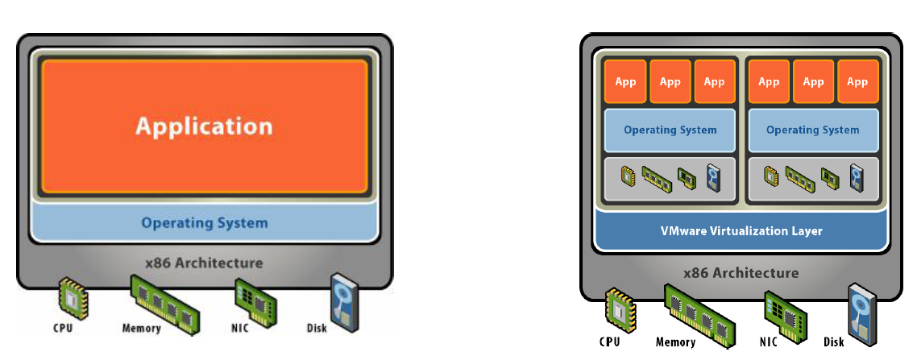
Virtualization

Slide 4
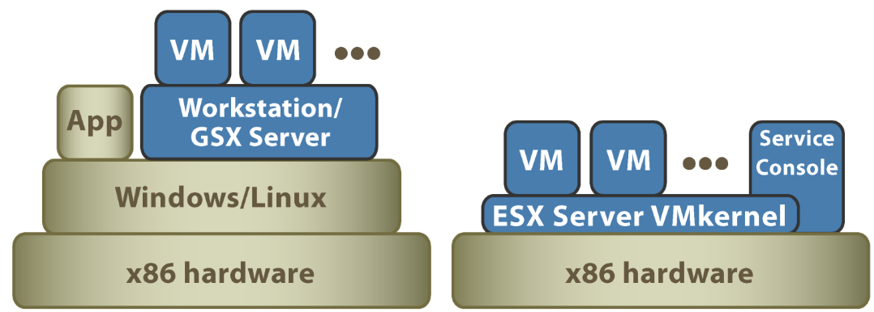
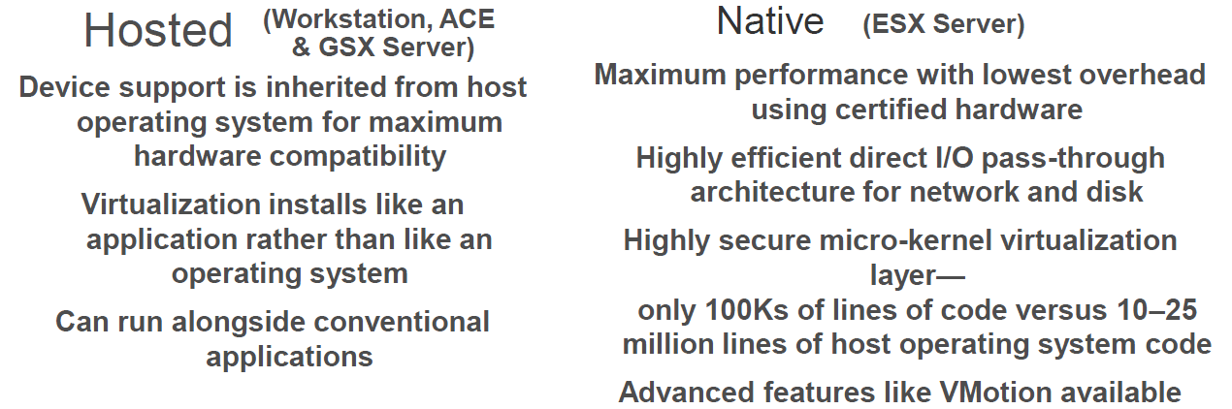
Hosted vs Native

Slide 5
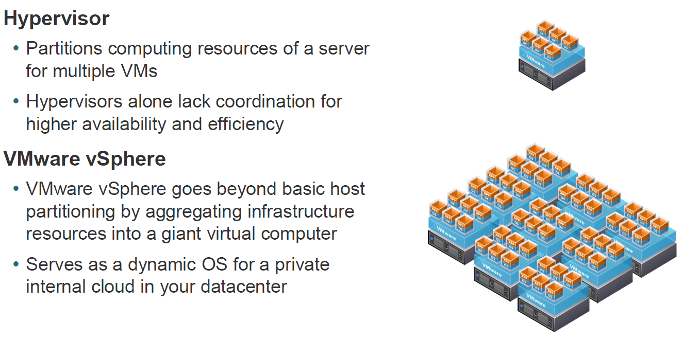
Hypervisor

Slide 6
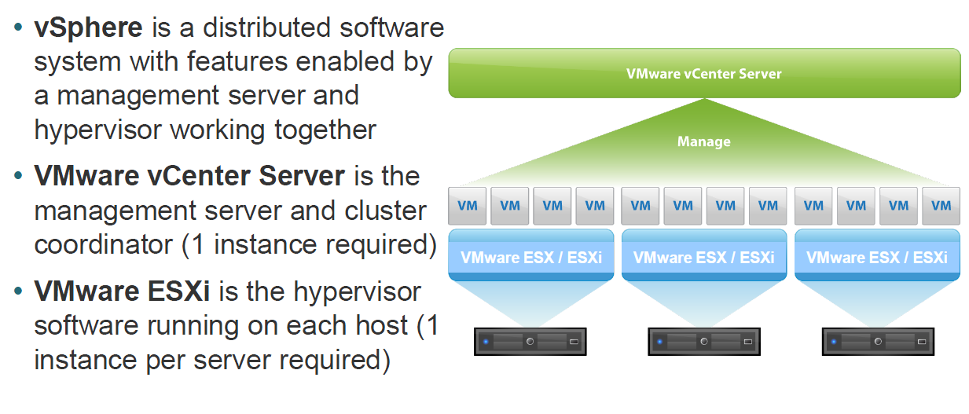
vSphere

Slide 7
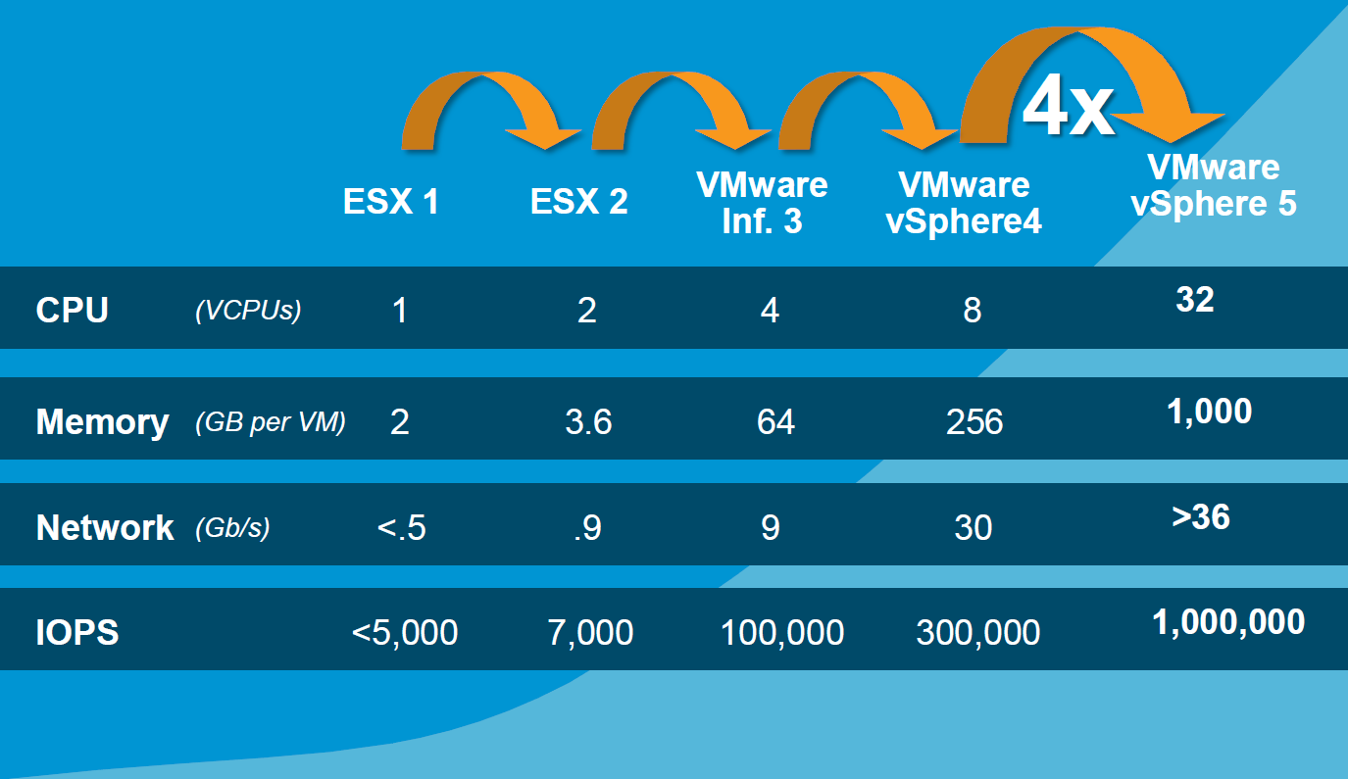
Evolution of vSphere

Slide 8
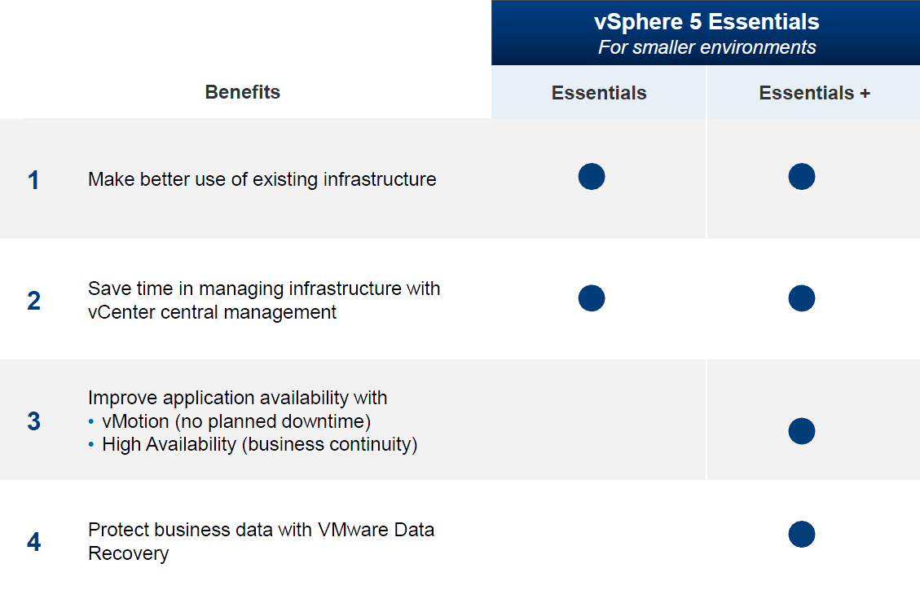
vSphere Essentials for SMB

Slide 9
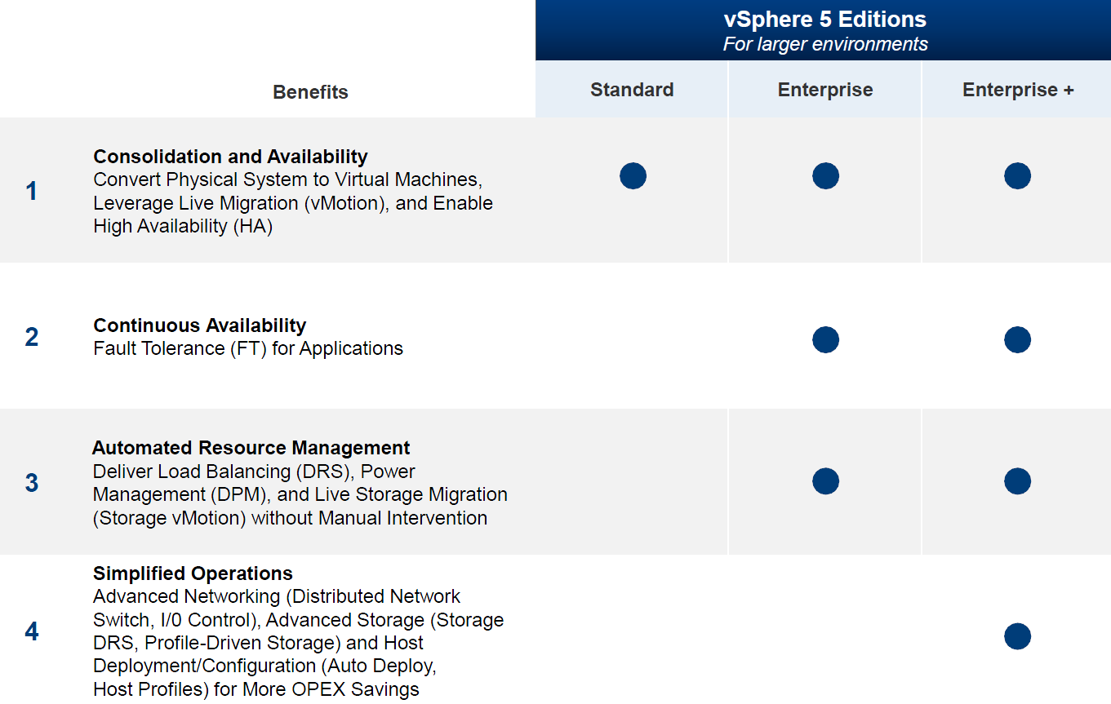
vSphere for Enterprises

Slide 10
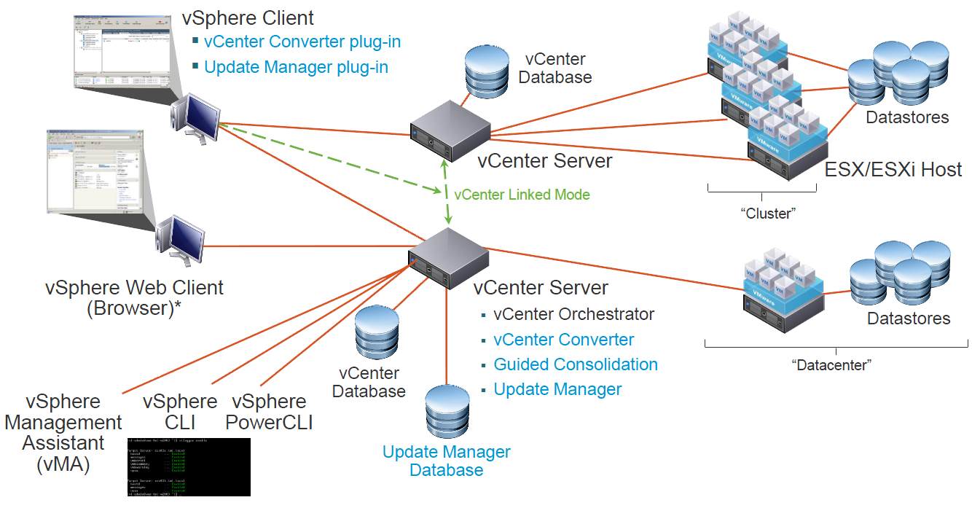
vSphere Architecture

Slide 11
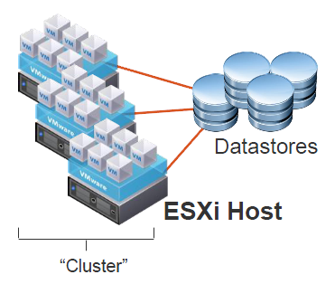
ESXi Host
Hypervisor running VMs
Organized into Clusters
Accesses shared storage datastores

Slide 12
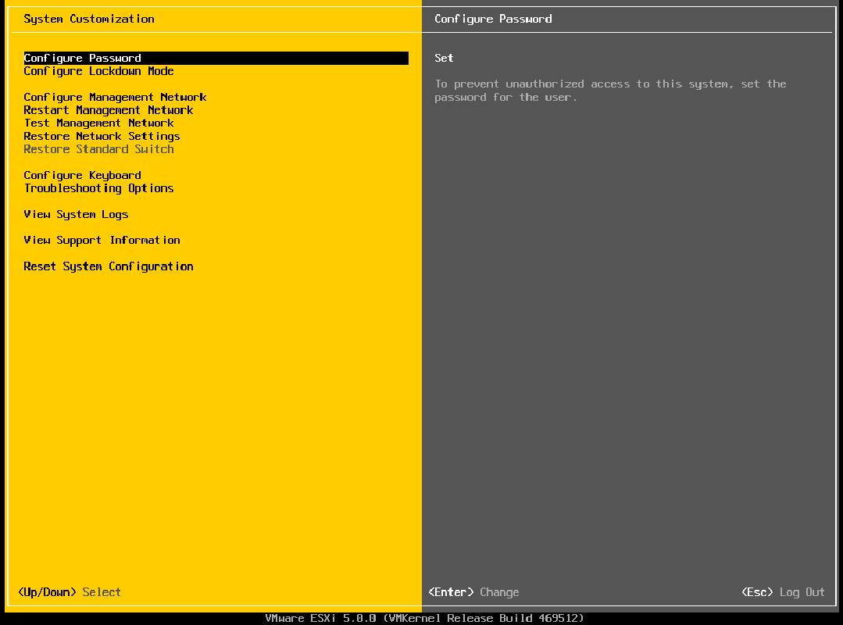
ESXi Console

Slide 13
ESXi Licensing
ESXi -> VMware vSphere Hypervisor
ESXi / VMware vSphere Hypervisor is free
Must be registered to remove nagmsg
Can be seamlessly upgraded to take advantage of advanced vSphere features

Slide 14
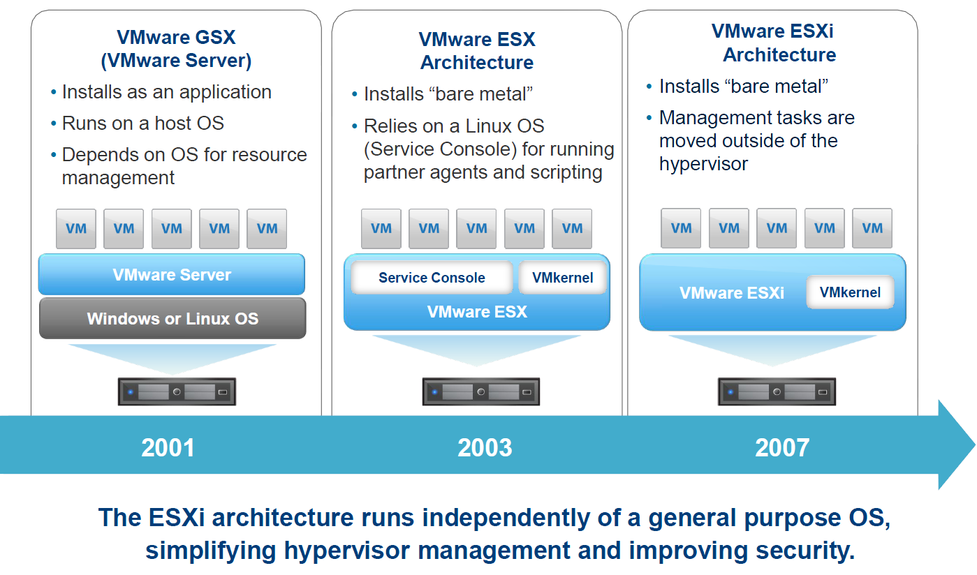
3rd Generation Hypervisor

Slide 15
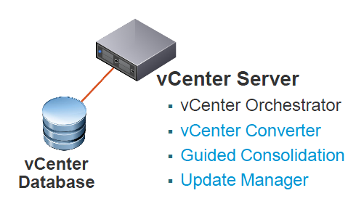
vCenter Server
Centralized manager of ESX/ESXi hosts
Runs as Windows services on physical or virtual server
Connects with:
  vCenter database (SQL Server or Oracle)
  Windows Active Directory (required for Linked Mode)
Integrates with optional server/client plug-ins

Slide 16
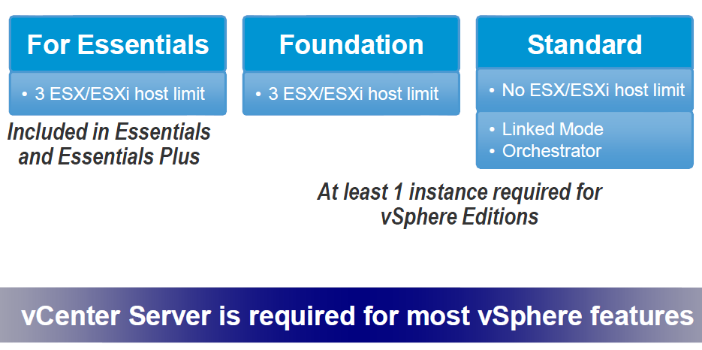
vCenter Licensing

Slide 17
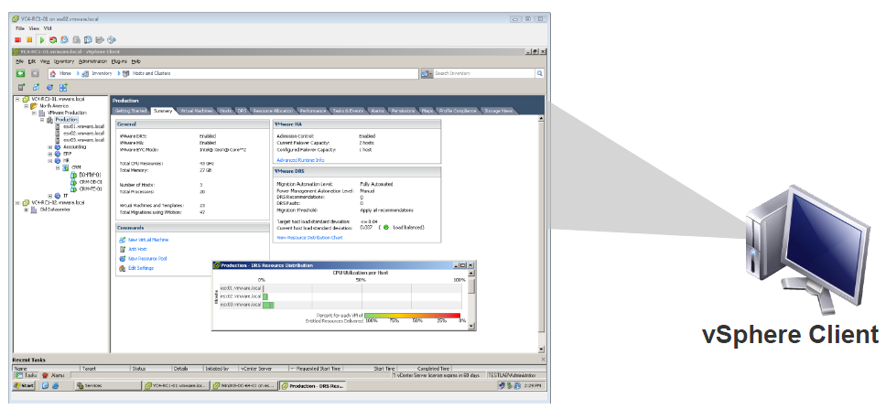
vSphere Client
Primary interface for administration
Runs locally on a Windows machine
Connects to vCenter Server or directly to an ESX/ESXi host

Slide 18
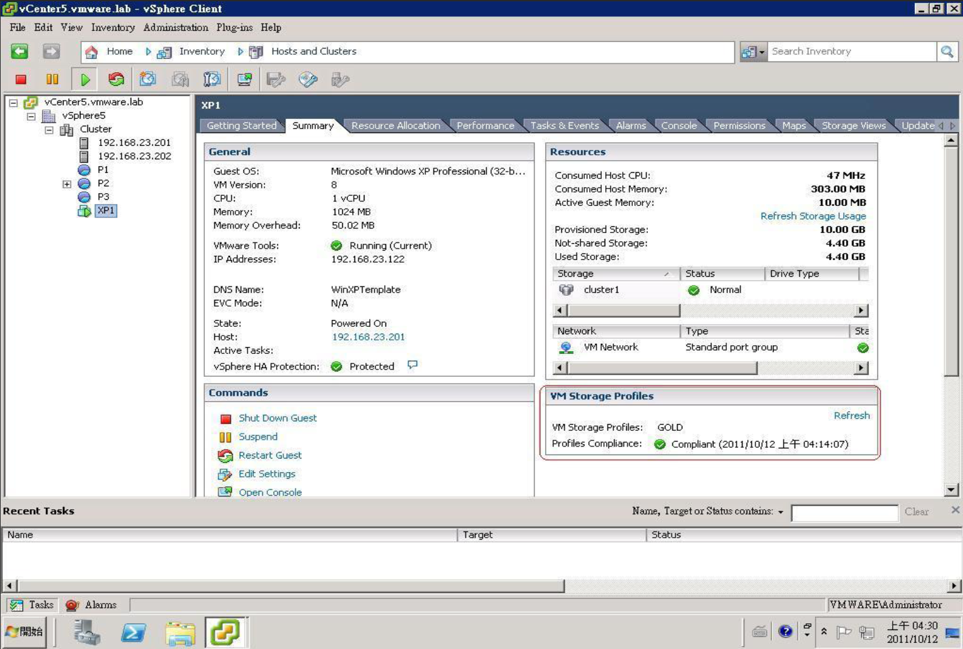
vSphere Client

Slide 19
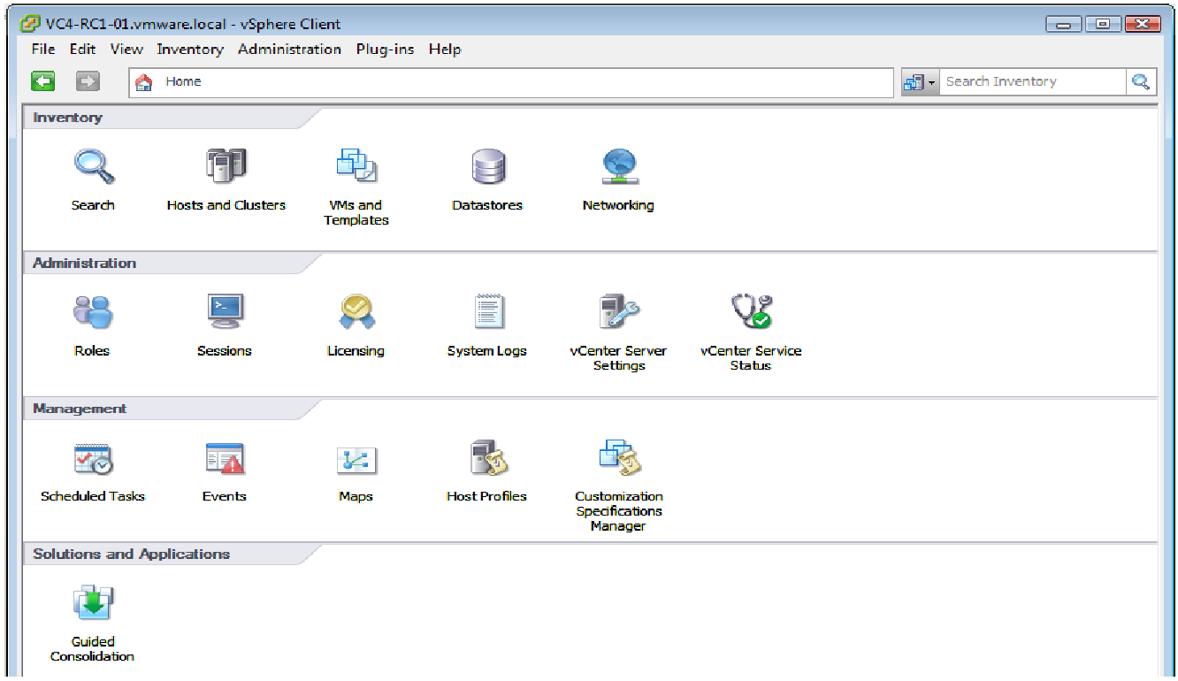
vSphere Client Home Menu

Slide 20
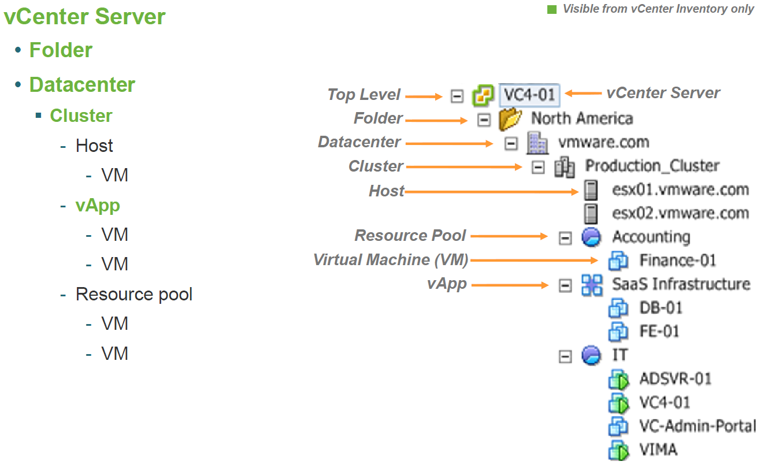
Inventory: Hosts & Clusters

Slide 21
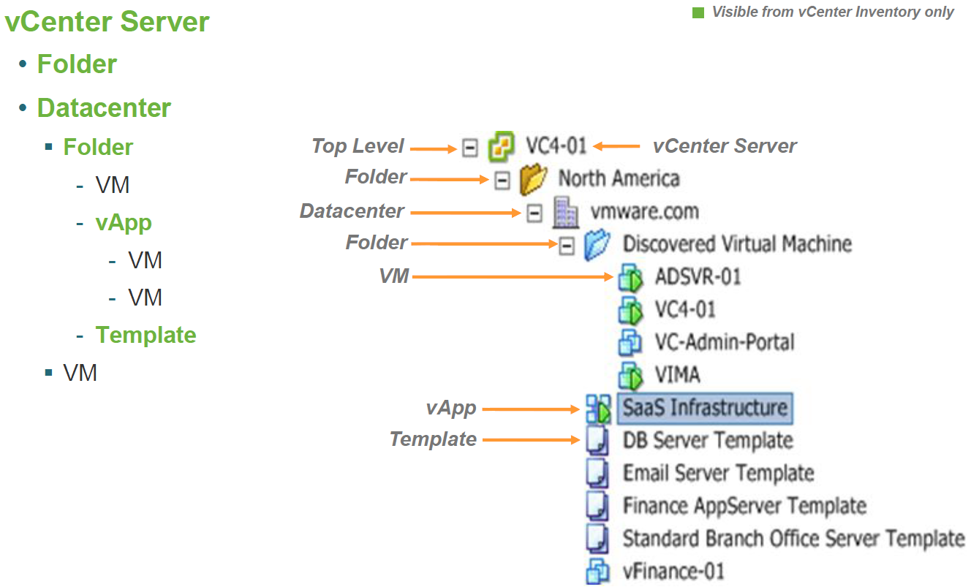
Inventory: VMs & Templates

Slide 22
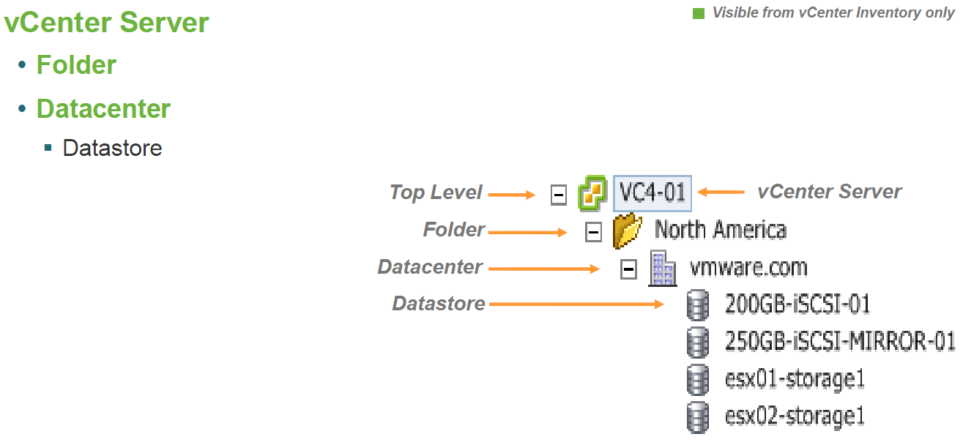
Inventory: Datastores

Slide 23
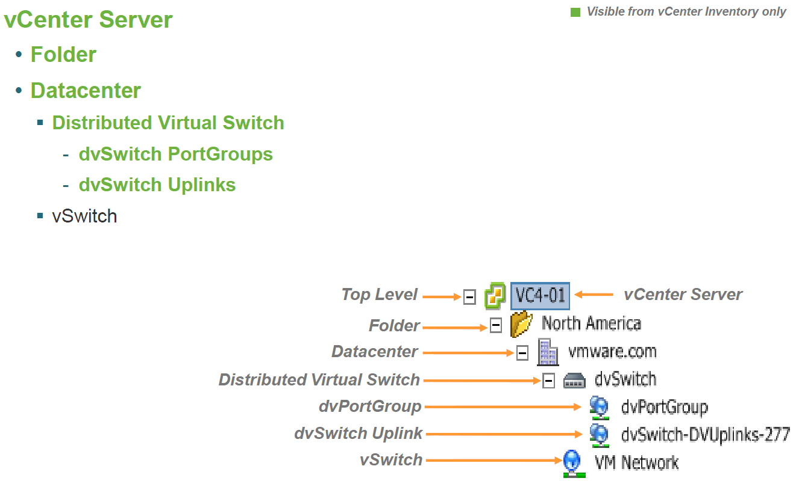
Inventory: Networking

Slide 24
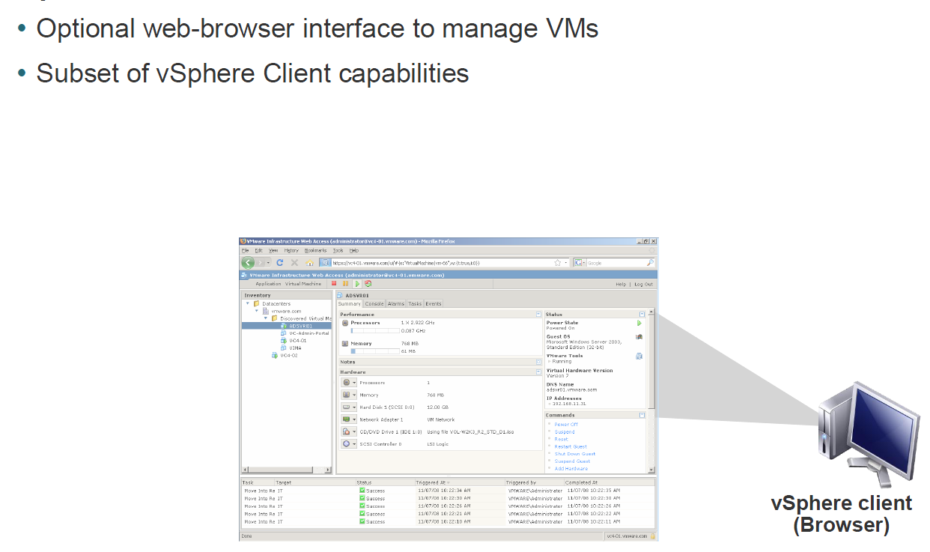
vSphere Web Client

Slide 25
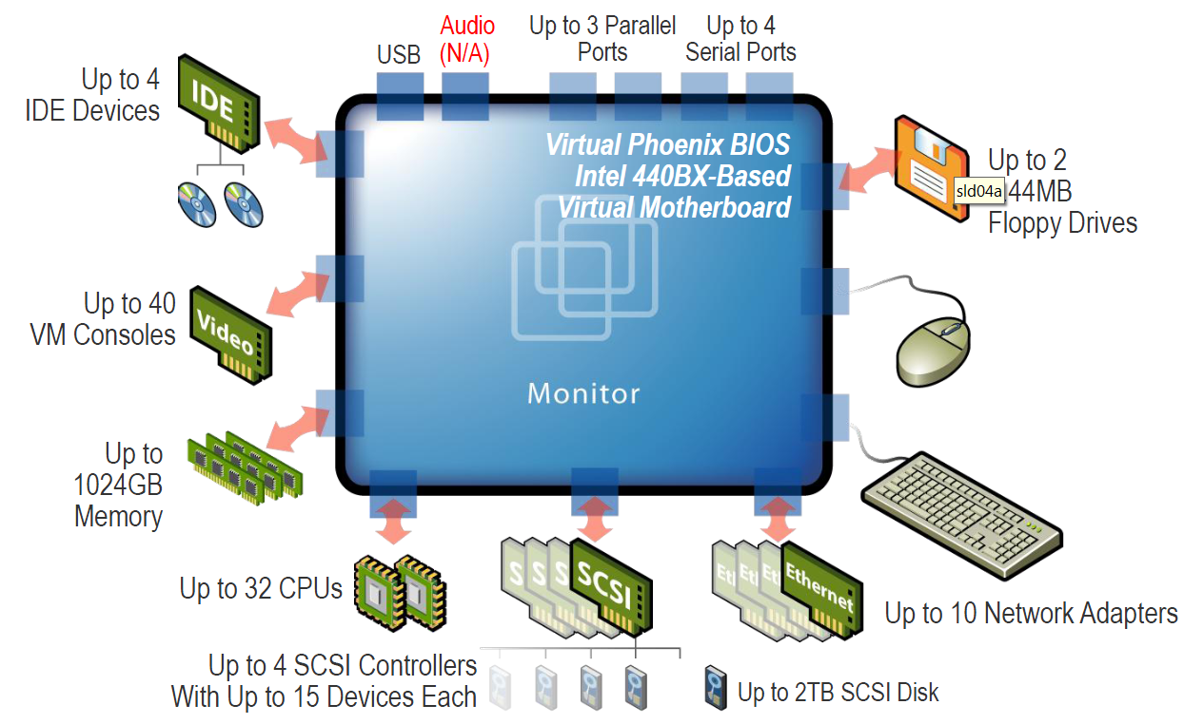
Virtual motherboard of a VM

Slide 26
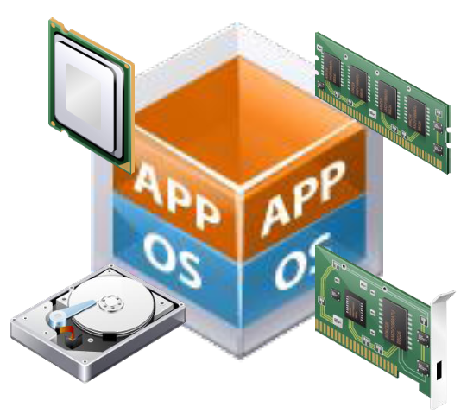
vSphere Features
Hot Add Virtual Devices
Hot add
  CPU
  Memory
Hot add or remove
  Storage devices
  Network devices

Slide 27
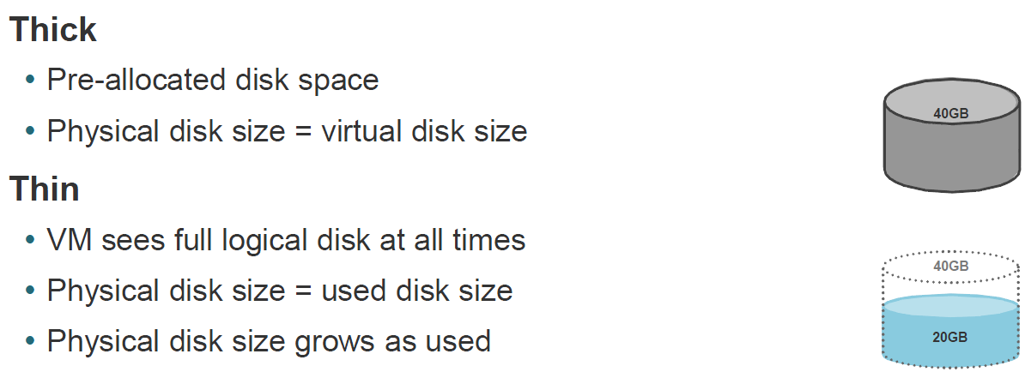
Virtual hard disk options

Slide 28
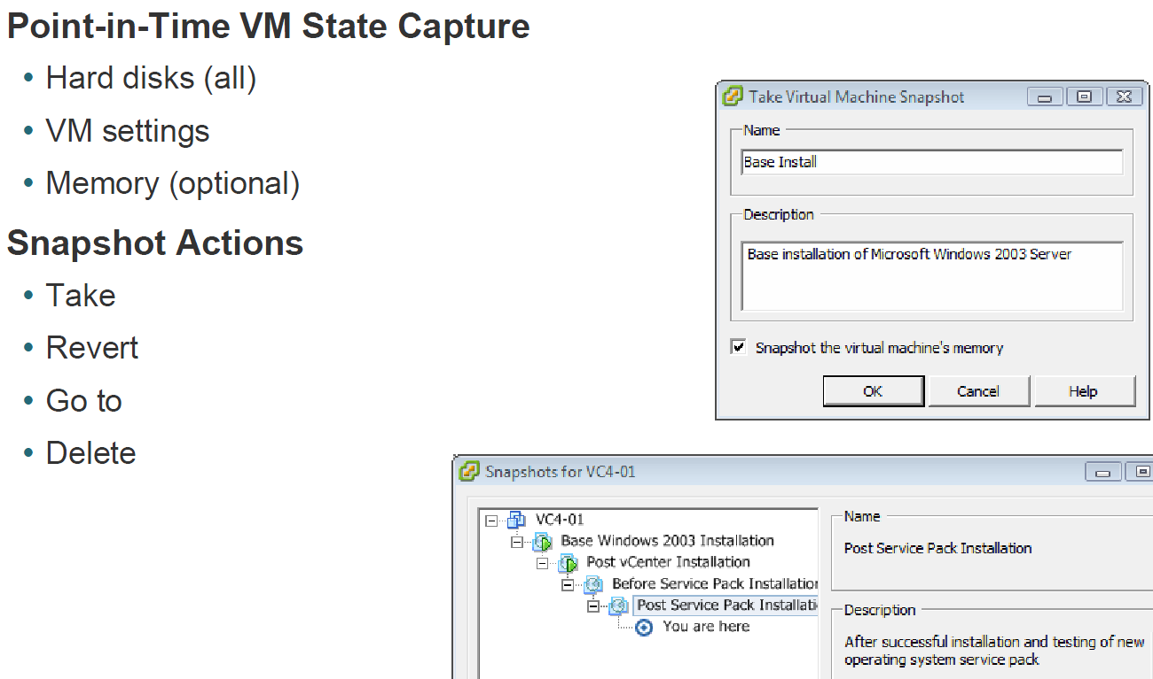
VM Snapshot

Slide 29
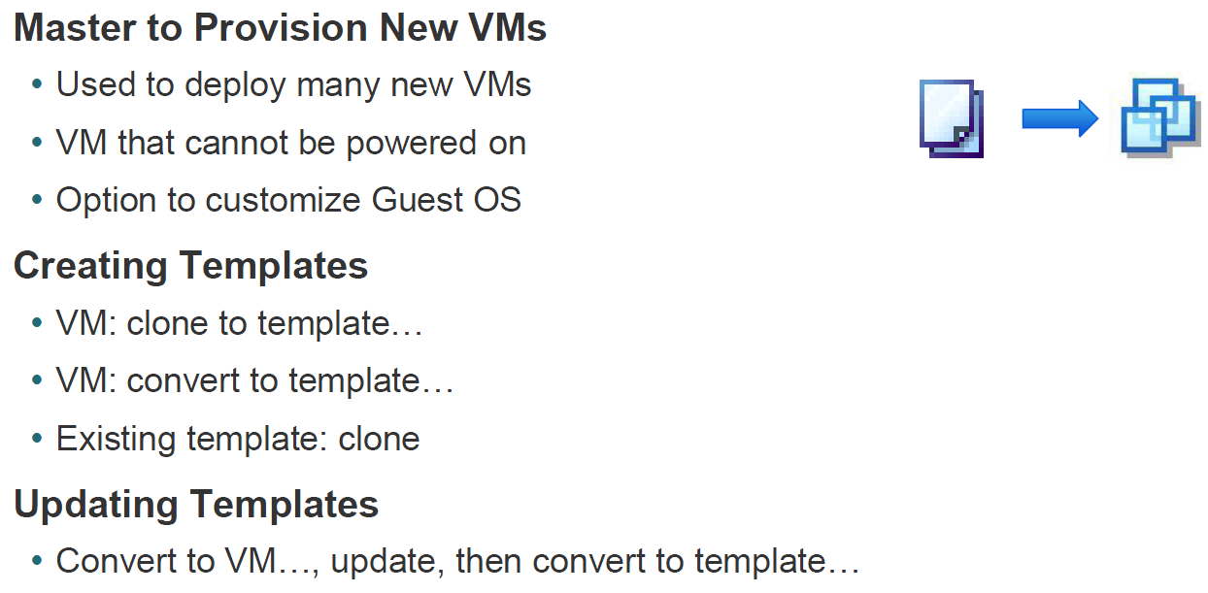
vSphere Templates

Slide 30
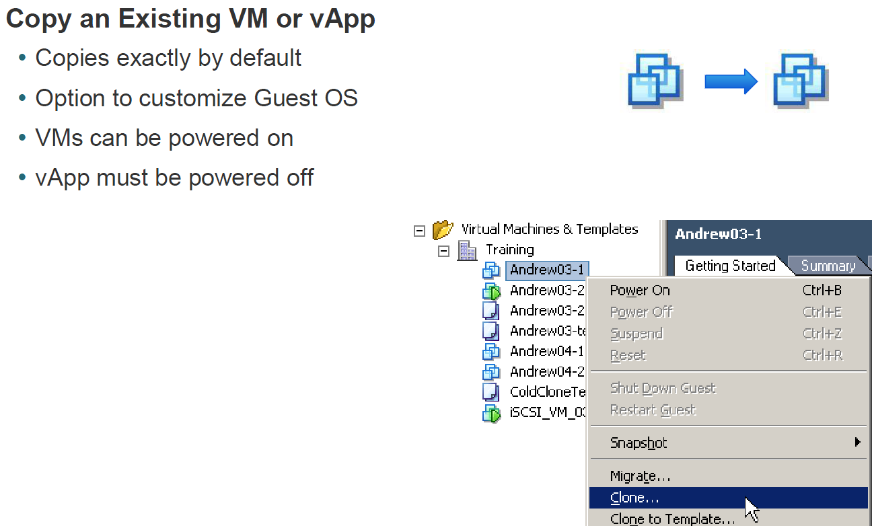
VM Cloning

Slide 31
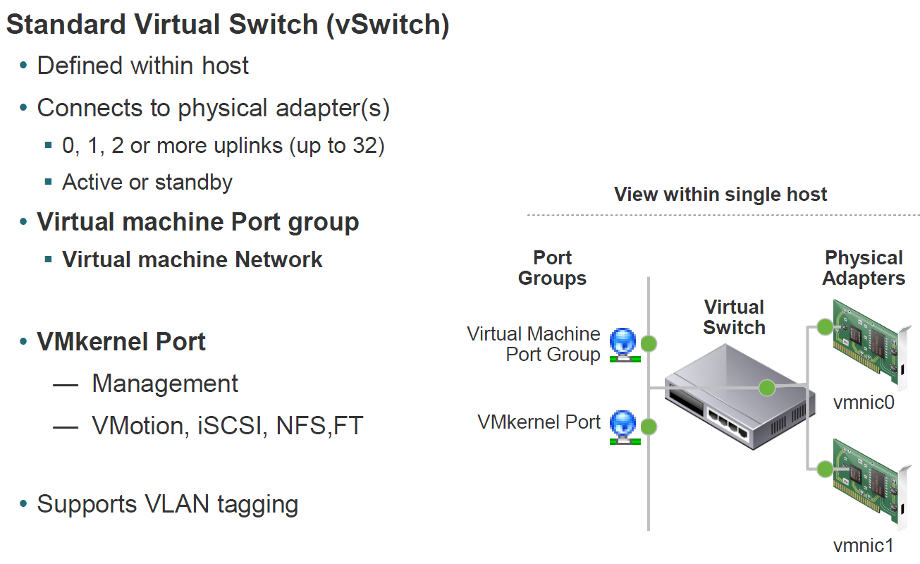
Virtual Networking

Slide 32
Network Terminology
vmnic: physical NIC in host computer
vswitch: virtual switch
vnic: virtual NIC in the virtual machine
vmhba: virtual host bus adaptor for SAN
virtual machine port group: a unique concept in a virtual environment. Roughly a port on a virtual switch, but multiple vnics can connect to the same port group
vmknic: virtual NIC in the VMkernel. Used by vMotion, NFS & iSCSI
Notes:
Port group is a unique concept in the virtual environment. A port group is a mechanism for setting policies
that govern the network connected to it. A vSwitch can have multiple port groups. Instead of connecting to a
particular port on the vSwitch, a virtual machine connects its vNIC to a port group. Virtual machines that
connect to the same port group belong to the same network inside the virtual environment even if they are on
different physical servers.

Slide 33
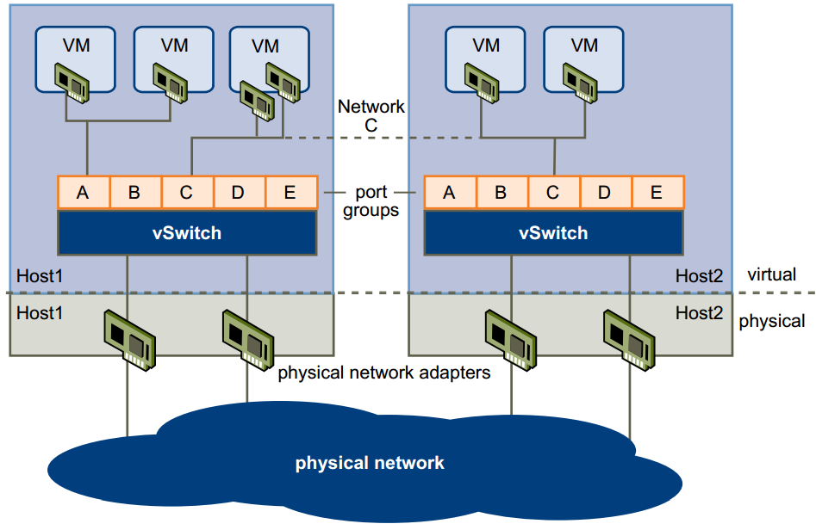
vSwitch: Virtual Switch

Slide 34
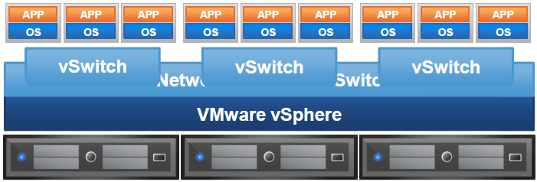
Distributed Switch
Aggregated datacenter-level virtual networking (vs. per-host)
Simplified management
Network statistics follow VMs

Slide 35
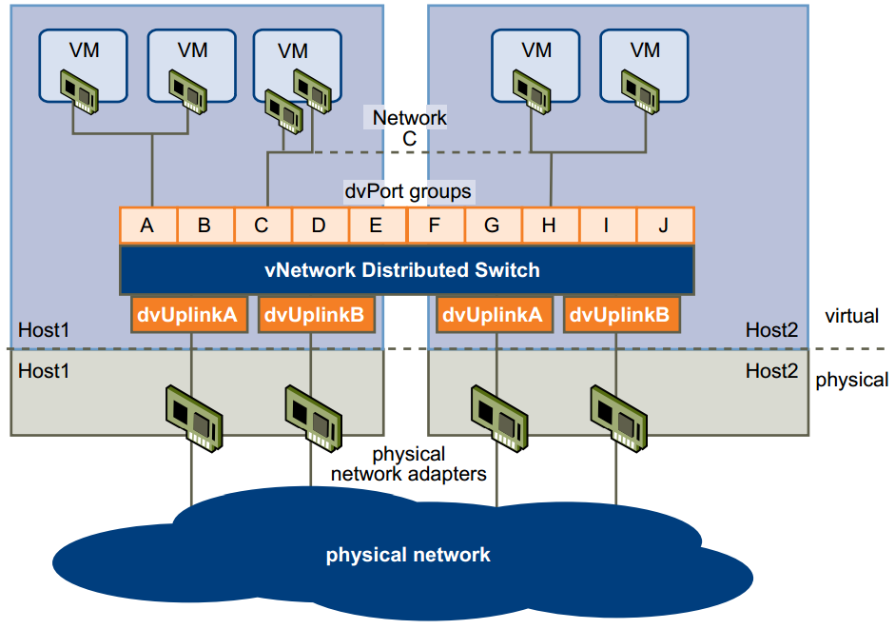
vDS: Virtual Distributed Switch

Slide 36
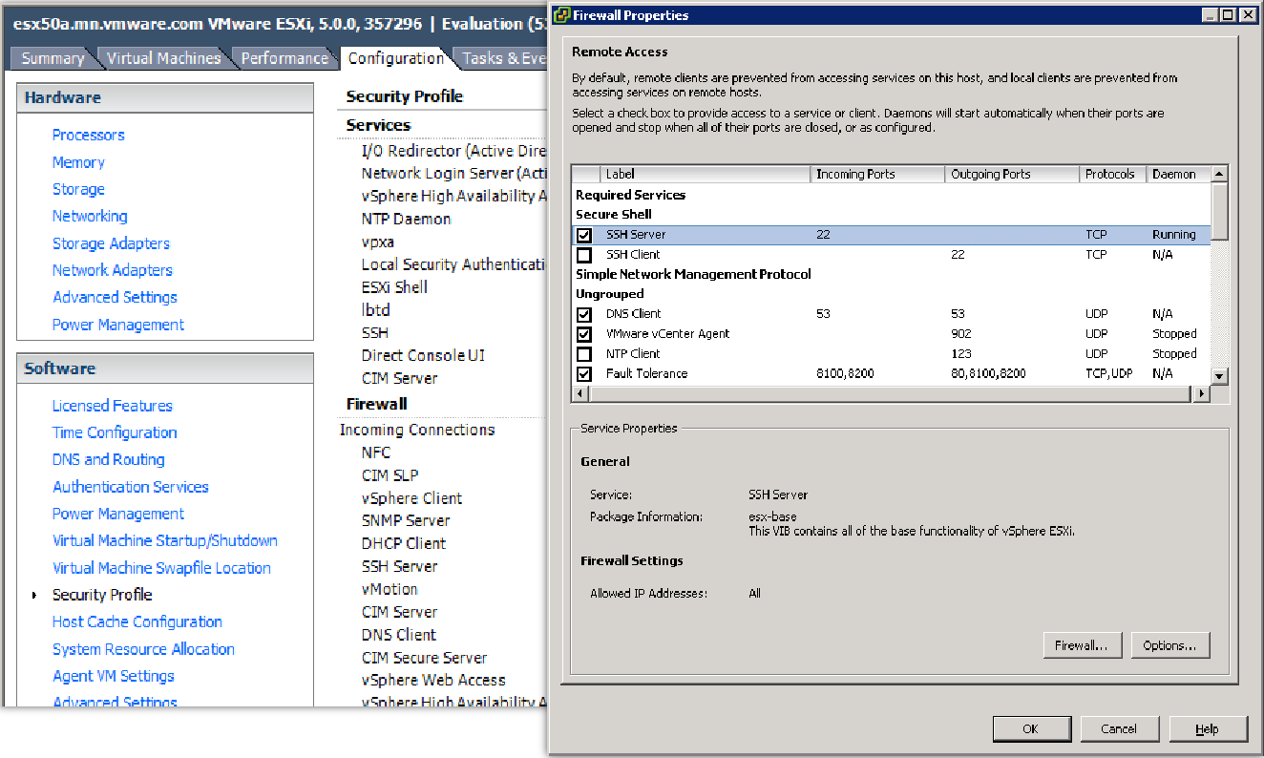
Centralized Network Management

Slide 37
Datastores
VMFS
NFS
DAS

Slide 38
VMFS Datastore
Shared VM file system
Block-level access by ESX/ESXi
Supported devices
  Local disk (not shared storage)
  Fibre Channel SAN
  iSCSI SAN
HBA
ESX/ESXi software initiator via VMkernel network port
Formats
  .vmdk
  RDM (raw device mapping) to underlying LUN

Slide 39
NFS Datastore
Shared directory on NFS server
File-level access by ESX/ESXi
Limitations
  No RDM

Slide 40
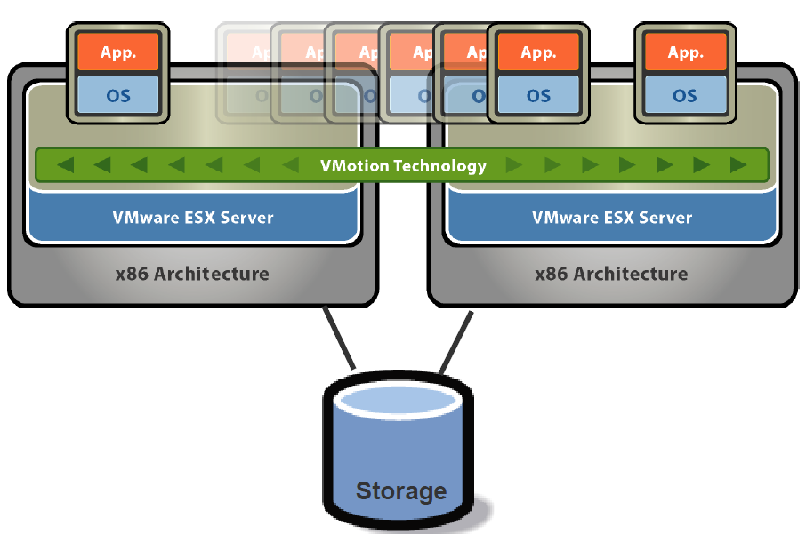
vMotion
Common
  Storage
  Networking

Slide 41
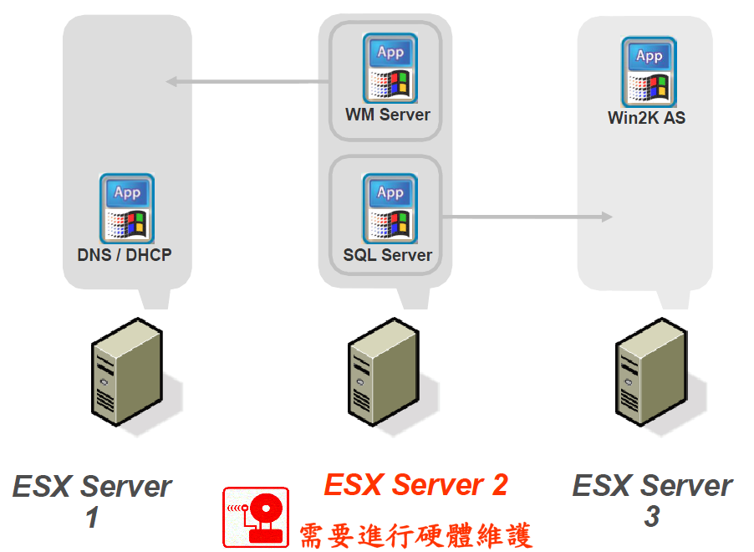
vMotion

Slide 42
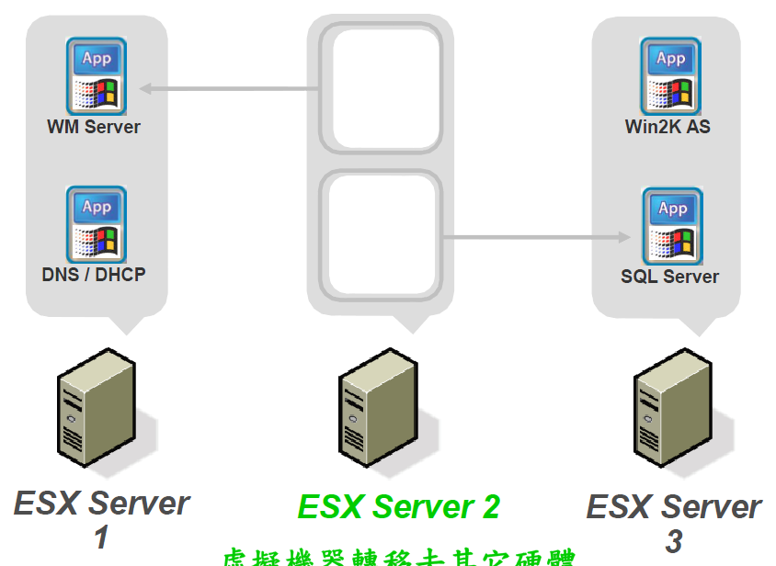
vMotion

Slide 43
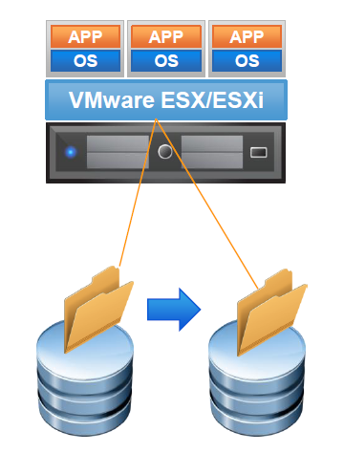
Storage vMotion
Relocate running VM from one datastore to another datastore with zero downtime
Relocate across different storage types
Change VM disk format (thick or thin)

Slide 44
Implementation
3 Dell R610 Servers
  2 x Quad Core 2.4GHz Xenon CPUs
  16GB RAM
  4 Gigabit NICs
  2 x 160GB SAS Drives
1 Force10 S50V 48 port POE GigE layer 2/3 switch
1 NetApp FAS2040
  Dual active-active controllers
  16 x 600GB SAS drives (4.8TB)
  16 x 1TB SATA drives (8TB)
  CIFS/NFS/iSCSI (HTTP/FTP/SSH)
vSphere Essentials Plus

Slide 45
Implementation
VMS1
VMS2
VMS2
NDS Admin
BarTender
VMS2
NDS Admin
BarTender
POS2000
DNC
TimeForce
SAV
FlexLM
PDC
FlexLM
PDC
Force 10 GigE
Storage Network
Multi-Path
SAS
FAS1
FAS2
SATA
NetApp 2040
GigE LAN
NIC Team
Notes:
45

Slide 46
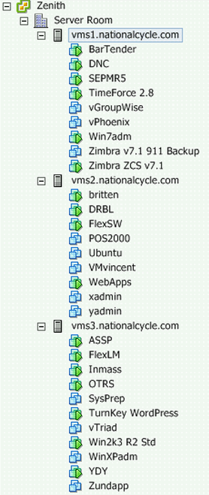
Virtual Machines
12 Production VMs
5 Admin VMs
5 Retired VMs
3 Development VMs
3 Test VMs
1 Misc VMs

Slide 47
Benefits
Snapshots:
  Contingency plan for software upgrades
  Easy to create development machines
Lower Expenses:
  OpEx – Less power and cooling costs
  CapEx – Fewer physical servers required
Deployment – Easier/Faster to deploy machines
Easy to support Legacy Hardware/Apps
  Huge Performance Boost
  Upgrade resources (memory, disk, CPU)
Quality vs Quantity

Slide 48
Lessons Learned
Terminology can be a problem
Link Agregation
  NetApp: trunking
  Force10: port-channel
  Cisco: EtherChannel
  vSphere: NIC teaming
NIC
  NetApp: vif (virtual interface)
  vSphere: vnic, vmnic, vmknic, vmhba
Can’t do everything in GUI
  Bind HBAs to vmnics
  Change MTU for Jumbo frames
Link Aggregation doesn’t work like you think
Didn’t understand how vLANs really work
Block alignment is very important

Slide 49
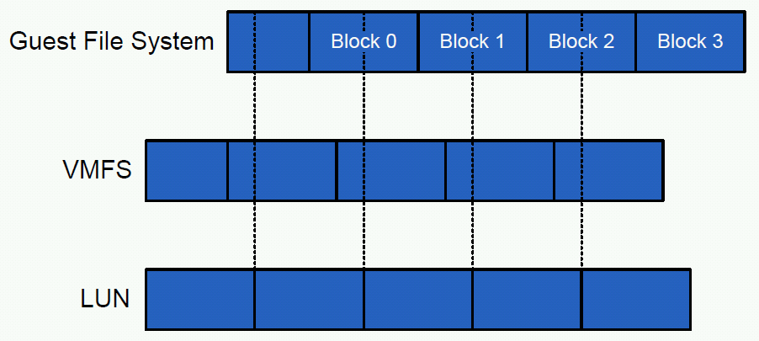
File System Misalignment
Read Block 0
  Reads 2 VMFS blocks
  Each VMFS block needs to read 2 LUN blocks
Notes:
Historically, hard drives (LUNs) presented the OS with a physical geometry that would be used to partition and format the disk efficiently. Disk geometry today is virtual and fabricated by the disk firmware. Operating system partitioning programs such as fdisk use the emulated disk geometry to determine where to begin a partition. Unfortunately, some partitioning programs invoked during OS setup create disk partitions that do not align with underlying block boundaries of the disk. Also, the more notable tools, such as GNU fdisk, found on many Linux® distributions; and Microsoft DiskPart, found on Windows 2000 and Windows 2003, by default also create disk partitions that do not align with underlying block boundaries of the disk. By default, many guest OSs, including most versions of Windows, attempt to align the first sector on a full track boundary. The installer/setup routine requests the Cylinder/Head/Sector (CHS) information that describes the disk from the BIOS (PC firmware that manages disk I/O at a low level), or, in the case of many VMs, an emulated BIOS. The issue is that the CHS data hasn't actually corresponded to anything physical, even in physical machines, since the late 1980s. At larger LUN sizes, usually 8GB or more, the sectors per track (S number) is always reported as 63, so the partitioning routine sets a starting offset of 63 sectors in an attempt to start the partition on a track boundary. While this may be correct for a single physical disk drive, it does not line up with any storage vendor's logical block size. A block is the smallest unit of data that can be used to store an object on a storage device. In order to make sure of optimal storage capacity and performance, data should reside in the blocks. Physical disk blocks always have 512 (usable/visible) bytes, but for efficiency and scalability reasons, storage devices use a logical block size that is some number of physical blocks, usually a power of 2. For example, NetApp Unified Storage Architecture arrays have a logical block size of 4K, that is, 8 disk blocks. EMC Symmetrix storage arrays have a logical block size of 64KB.

Slide 50
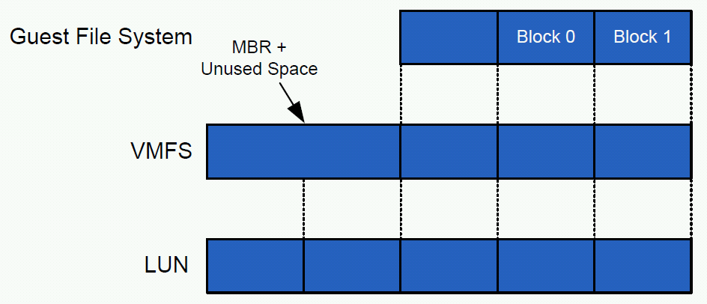
File System Alignment

Slide 51
OS Misalignments
All versions of windows misalign filesystem, except:
  Vista/Win7
  Windows 2008 Server +
All versions of RHEL, except:
  RHEL 6 +
Best Practices for File System Alignment in Virtual Environments
NetApp TR-3747
January 2011
Notes:
By default, many guest operating systems, including Windows 2000, Windows 2003, and various Linux distributions, start the first primary partition at sector (logical block) 63. The reasons for this are historically tied to disk geometry. This behavior leads to misaligned file systems because the partition does not begin at a sector that is a multiple of 8. Note that Windows Server 2008 and Windows Vista® default at 1,048,576, which is divisible by 4,096, and do not require any adjustments. Also, RHEL 6 does not require any adjustments because it aligns its partitions properly by default.

Slide 52
Technology Learned
FTOS
Link Aggregation
Multi-pathing
iSCSI
vLANs
LACP
vSphere

