Slide 1
IPv6 – The Next Generation of Internet Protocols
Presentation by Jon Evans for Uniforum Chicago on November 30, 2010

Slide 2
MANDATE
Federal CIO Vivek Kundra has issued a directive requiring all U.S. government agencies to upgrade their public-facing Web sites and services by Sept. 30, 2012 to support IPv6…
Network World. Sept. 28, 2010

Slide 3
CHINA
Used it for the 2008 Olympic Games in their Network Infrastructure.
CNGI – China Next Generation Internet

Slide 4
IPv4
I. Origins
Deployed on January 1, 1983
II. Description
A. 32 bit address in a series of four 8-bit numbers . Largest 8-bit number is 255. Can identify 2³² addresses.
B. Based on binary. Only two values – 0 and 1.
C. Represented in decimal notation.
D. All IP addresses composed of Network ID and Host ID
III. Classes
A - 0.0.0.0 to 127.255..255.255
B - 128.0.0.0 to 191.255.255.255
C - 192.0.0.0 to 233.255.255.255
D - 244.0.0.0 to 239.255.255.255 (Multicast)
E - 240.0.0.0 to 255.255 .255.255 (Reserved)

Slide 5
Types of IPv4
IV. Private addresses
A. Developed by the IANA
B. Not routed
C. Class A: 10.0.0.0 to 10.255.255.255
D. Class B: 172.16.0.0 to 172.31.255.255
E. Class C: 192.168.0.0 to 192.168.255.255
V. APIPA (Automatic Private IP Addressing)
A. DHCP Failover mechanism for Windows.
B. Range 169.254.0.1 to 169.254.255.254
VI. CIDR (Classless Inter-Domain Routing)
A. Implemented in 1993 because IP addresses being depleted.
B. Variable Length Subnet Mask (VLSM) is used to create additional addresses.
C. Written in standard 4 part dotted decimal followed by /N (0 to 32).
Example: 212.43.43.33/27. Indicates network prefix.

Slide 6
IPv4
VII. Special types
A. 0.0.0.0/8 - Current network
B. 14.0.0.0/8 - Public-Data Networks
C. 24.0.0.0/8 - Cable Television Networks
D. 39.0.0.0 - Reserved but subject to allocation
E. 127.0.0.1/8 - Loopback
F. 128.0.0.0/16 - Reserved but subject to allocation
G. 191.255.0.0/16 - Reserved but subject to allocation
H. 192.0.0.0 /24 - Reserved(IANA)
I. 192.0.2.0/24 - TEST-NET-1

Slide 7
IPv4
VII. Special types
J. 192.88.99.0/24 - IPv6 to IPv4 relay (To allow 6to4 addresses to exchange traffic with native IPv6 addresses)
K. 198.18.0.0/15 - Network benchmark tests
L. 198.51.100.0 /24 - TEST-NET-2
M. 203.0.113.0/24 - TEST-NET-3
N. 223.255.255.0/24 - Reserved but subject to allocation
O. 224.0.0.0/4 - Multicasts
P. 223.255.255.0/24 - Reserved but subject to allocation
Q. 240.0.0.0/4 – Reserved
R. 255.255.255.255 - Broadcast

Slide 8
IPv5
I. Meant for test/research
II. Known as ST, then ST2.
III. RFC 1819

Slide 9
IPv6
I. Origins
A. RFC 2460 on December 1998
B. Once known as IP-The Next Generation (IPng)
II. Basic concepts
A. Larger address space
B. Better routing
C. Easier host configuration
D. Built-in security
E. More efficient priority delivery
F. Headers redesigned for better processing and extensibility
III. Description
A. 128 bit address in a series of eight 16 bit fields separated by colons. Can identify 2¹²⁸ addresses.
B. Based on binary. Only two values – 0 and 1.
C. Represented in hexadecimal notation
D. Group zeros with :: (Only once)
E. Network portion is represented by a slash at the end and the number of prefix bits for the network.
Examples
3ffe:1900:4545:3:200:f8ff:fe21:67cf
fe80::884:e09:d546:aa5b

Slide 10
IPv6 ADDRESS CATREGORIES
I. Unicast
A. Ways to get the interface id.
1. Unicast addresses with the prefixes 001 to 111 must use a 64-bit ID derived from the Interface Identifier.
2. Interface ID can be randomly generated for anonymity.
3. Assigned during stateful addressing.
4. Manually configured.
B. Types
1. Link-Local
2. Unique-Local
3. Global
II. Multicast
Anycast
Special

Slide 11
Types of IPv6 addresses
I. Unicast
A. Link-local address (APIPA address in IPv4)
1. Not routed
2. Stateless address auto-configuration when DHCP not available
3. Starts with fe80::
4. Contains
a. 10 bits: 1111111010
b. 54 bits: 0
c. 64 bits: Interface ID

Slide 12
Types of IPv6 addresses
I. Unicast
B. Unique-local (Private address in IPv4)
1. Used to be called Site-local addresses
2. RFC 4193
3. Also called unique local unicast address or local IPv6 address.
4. Not routed
5. Used within a site
6. Begins with FE and has C to F for third hex
7. Contains
a. 7 bits: 1111111 (Prefix)
b. 1 bit: Set to 1 if assigned locally. If 0, may be defined in future
c. 40 bits: Global ID
d. 16 bits: Subnet ID
e. 64 bits: Interface ID

Slide 13
Types of IPv6 addresses
C. Global Unicast address (Public address in IPv4)
1. Starts with 001 (2000::/3) through 111 (E000::/3)
2. Contains
a. 48 bits: Global routing prefix
b. 16 bits: Subnet ID
c. 64 bits: Interface ID (MAC address in IPv4)
II. Multicast address
A. Contains
1. 8 bits: Prefix
2. 4 bits: Flag bits
3. 4 bits: scope
4. 8 bits: Reserved
5. 8 bits: Plen (Length of the prefix in the prefix field)
6. 64 bits: Network Prefix
7. 32 bits: Group ID

Slide 14
Types of IPv6 addresses
B. Fixed Scope Multicast
1. Interface-Local
a. ff01::1 - All Node-Local Nodes
b. ff01::2 - All Node-Local Routers
2. Link-Local
a. ff02::1 - All Link-Local Nodes
b. ff02::2 - All Link-Local Routers
c. ff02::3 - Unassigned
d. ff02::4 - Link-Local DVMRP Routers
e. ff02::5 - Link-Local OSPFIGP
f. ff02::6 - Link-Local OSPFIGP Designated Route
g. ff02::7 - Link-Local ST Routers

Slide 15
Types of IPv6 addresses
h. ff02::8 - Link-Local ST Hosts
i. ff02::9 - Link-Local RIP Routers
j. ff02::A - Link-Local EIGRP Routers
k. ff02::B - Link-Local Mobile-Agents
l. ff02::D - All Link-Local PIM Routers
m. ff02::E - Link-Local RSVP- ENCAPSULATION
n. ff02::16 – All MLDv2-capable routers
o. ff02::6A – All Snoopers
p. ff02::1:1 - Link-Local Link Name
q. ff02::1:2 - Link-Local All-dhcp-agents
r. ff02::1:FFXX:XXXX - Link-Local Solicited-Node address

Slide 16
Types of IPv6 addresses
3. Unique-Local
a. ff05::1:2 – All Routers address
b. ff05::1:3 – All DHCP servers
c. ff05::1:4 – Depreciated
d. ff05::1:1000 to ff05::1:13ff – Service Location (SLP) Version 2
- In the following, the service is in the Group ID. For example, ff02::101 means the NTP servers in the local network. The Group ID can be additionally divided.

Slide 17
Types of IPv6 addresses
B. Permanently assigned multicast addresses independent of scopes.
1. ff0x:: - Reserved
2. ff0x::101 - Network Time Protocol
3. ff0x::102 - SGI-Dogfight
4. ff0x::103 - Rwhod
5. ff0x::104 - VNP
6. ff0x::105 - Artificial Horizons – Aviator
7. ff0x::106 - NSS – Name Service Server
8. ff0x::107 - AUDIONEWS – Audio News Multicast
9. ff0x::108 - SUN NIS+ Information Service
10. ff0x::109 - MTP Multicast Transport Protocol

Slide 18
Types of IPv6 addresses
11. ff0x::10A - IETF-1-LOW-AUDIO
12. ff0x::10B - IETF-1-AUDIO
13. ff0x::10C - IETF-1-VIDEO
14. ff0x::10D - IETF-2-LOW-AUDIO
15. ff0x::10E - IETF-2-AUDIO
16. ff0x::10F - IETF-2-VIDEO
17. ff0x::110 - MUSIC-SERVICE
18. ff0x::111 - SEANET-TELEMETRY
19. ff0x::112 - SEANET-IMAGE
20. ff0x::113 - MLOADD
21. ff0x::114 - Any private experiment
22. ff0x::115 - DVMRP on MOSPF
23. ff0x::116 - SVRLOC

Slide 19
Types of IPv6 addresses
24. ff0x::117 - XINGTV
25. ff0x::118 - microsoft-ds
26. ff0x::119 - nbc-pro
27. ff0x::11A - nbc-pfn
28. ff0x::11B - lmsc-calren-1
29. ff0x::11C - lmsc-calren-2
30. ff0x::11D - lmsc-calren-3
31. ff0x::11E - lmsc-calren-4
32. ff0x::11F - ampr-info
33. ff0x::120 - mtrace
34. ff0x::121 - RSVP-encap-1
35. ff0x::122 - RSVP-encap-2
36. ff0x::123 - SCRLOC-DA
37. ff0x::124 - rln-server
38. ff0x::125 - proshare-mc

Slide 20
Types of IPv6 addresses
39. ff0x::126 - dantz
40. ff0x::127 - cisco-rp-announce
41. ff0x::128 - cisco-rp-discovery
42. ff0x::129 - gatekeeper
43. ff0x::12A - iberiagames
44. ff0x::201 - “rwho” Group (BSD) (unofficial)
45. ff0x::2:0000 to ff0x::2:7ffd Multimedia Conference Calls
46. ff0x::2:7ffe - SAPv1 Announcements
47. ff0x::2:7fff - SAPv0 Announcements
48. ff0x::2:8000 to ff0x::2:fff - SAP Dynamic Assignments

Slide 21
Types of IPv6 addresses
III. Anycast addresses
A. Cross between a unicast and multicast address.
B. A group of interfaces usually on separate nodes. C. When packets are sent, they are sent to the nearest interface based on routing protocol distance measurement.
D. Mobile IPv6 uses this.
IV. Zones
A. A network address can be assigned a scope zone.
B. A link-local zone is made up of all network interfaces connected to a link.
C. Addresses are unique within a zone.
D. A zone index suffix on the address identifies the zone.
Example:
fe80::884:e09:d546:aa5b%10

Slide 22
Types of IPv6 addresses
IV. Special
A. Unspecified – 0:0:0:0:0:0:0:0 or ::
B. Loopback - 0:0:0:0:0:0:0:1 or ::1
C. Addresses compatible with IPv4 - ::/96
D. Mixed IPv4 and IPv6
1. Puts values of IPv4 address into low order bytes of IPv6
2. Example
0:0:0:0:0:0:192.168.100.1
E. 6to4
Prefix of 2002::/16
F. ISATAP
G. Teredo
Prefix of 2001::/32

Slide 23
ADDRESSES REQUIRED
I. For Each Host
A. Link-local address for each interface
B. Any assigned unicast and anycast addresses
C. Loopback address
D. All-nodes multicast address
E. Solicited-node multicast address for each assigned unicast and anycast addresses.
F. Multicast addresses of other groups the host is a member of.
II. For each router
A. Needs to recognize the above
B. Subnet-router anycast address for the interfaces it is a router for.
C. All anycast addresses for which the router is configured for.
D. All-routers multicast address
E. Multicast addresses of groups the router belongs to.

Slide 24
IPv6 in Ethernet (RFC 2464)
I. Pv6 address (Link-Local)for Ethernet Interface contents
A. Interface Identifier
1. Based on the EUI-64 identifier
a. Can be made from MAC-48 or EUI-48
- OUI (First 3 octets) becomes the company_id
- 4th and 5th octets - FFFE
Example:
34-56-78-9A-BC-DE becomes
36-56-78-FF-FE-9A-BC-DE
2. Complement of the Universal/Local (U/L)bit 0 becomes a 1
B. Interface Identifier is then appended to FE80::/64
Diagram:
10 bits 54 bits 64 bits
+ ------------------+-------------------------------+-------------------------------------+
| 1111111010 | (Zeros) | Interface Identifier |
+-------------------+-------------------------------+-------------------------------------+

Slide 25
IPv6 in Ethernet (RFC 2464)
II. Ethernet Frame
A. Ethernet Header
1. Destination Ethernet address
2. Source Ethernet address
3. Ethernet type code – Must be 86DD
B. Data Field
1. IPv6 Header
2. Payload
III. MTU
Max is 1500 octets

Slide 26
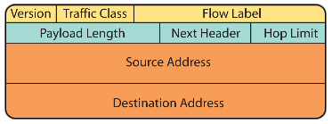
IPV6 HEADER

Slide 27
IPV6 HEADER EXPLAINED
I. First 40 bytes of Data packet.
II. Fields
A. Version/IP Version (4 bits)
Has the number 6
B. Traffic class/Packet Priority (8 bits)
1. Field used by the source node and routers
2. Replaces Type of Service field in IPv4
C. Flow Label/Flow Management(20 bits)
1. Identified by together with source address and non-zero flow label
2. The way to handle the flow may be in the data packet or with RSVP(Resource Reservation Protocol)
D. Payload Length in bytes (16 bits)
1. Length field in IPv4 includes the IPv4 Header itself but this doesn’t.
2. Extension Headers included in value
3. Length of data field following the header
4. Upper limit – 64 KB
5. Jumbogram is indicated with a zero.

Slide 28
IPV6 HEADER EXPLAINED
E. Next Header (8 bits)
1. In IPv4 this is the Protocol Type field
2. Type of header following current one.
3. Usually transport layer protocols.
4. Two most common types
a. TCP – 6
b. UDP - 17
5. If Extension Headers are used, this is the type of the Extension Header
F. Hop Limit/Time to Live (8 bits)
1. TTL field in IPv4
2. Decremented by 1 by each router.
3. 255 max
G. Source address (128 bits)
H. Destination address (128 bits)

Slide 29
EXTENSION HEADERS
I. Explanation
A. Inserted only if needed. There can be zero or more.
B. RFC 2460
C. Between the IPv6 Header and the upper layer protocol header.
D. Examined usually only by the destination of single address or by all nodes representing the multicast. Exception – Hop-by-Hop inspected by each node in the path.
II. Extension Headers in order they would appear
A. Hop-by-Hop Options
1. Next Header
2. Header Extension Length
3. Options
a. Jumbogram
- If Payload Length has 0 in the IPv6 field, then Hop-by-Hop Options Header is looked at.
- If option is 194, then there is a Jumbo Payload.
- Supports packets between 65,536 to 4,294,967,295 bytes
b. Router alert
For routers to notice. Regular data packets can pass through.

Slide 30
EXTENSION HEADERS
B. Routing
1. To give a list of nodes to visit along the way
2. Fields
a. Next Header
b. Header Extension Length
c. Routing Type
d. Segments Left
e. Type-Specific Data
3. Next Header field in the IPv6 Header field is 43 for this Extension Header
4. This Header comes into play for 6to4 transition. The source and destination addresses have the prefixes 2002.

Slide 31
EXTENSION HEADERS
C. Fragment
1. Source host uses Path MTU discovery to see of packet is too large for path. If that is the case, it fragments the packets. Routers in IPv4 fragment the packets. Reassembly is done at the destination.
2. Preceding Header has 44 in Next Header field for this Header to come into play.
3. Fields
a. Next Header
b. Reserved
c. Fragment Offset
d. Reserved
e. M-Flag
1: More fragments
0: Less fragments
f. Identification
4. Unfragmented original is in every fragment. Then the fragment header and the fragment.
5. If all fragments are 60 seconds late after the first one, all are discarded.

Slide 32
EXTENSION HEADERS
D. Destination Options
1. Examined by the destination only.
2. 60 in the Next Header of the previous header indicates this one.
3. Can appear twice in a IPv6 packet.
a. If before Routing Header, it has information for the routers to process
b. If before the upper layer protocols, there is information for the destination.
4. Fields
a. Next Header
b. Header Extension Length
c. Options

Slide 33
ICMPv6 (Internet Control Message Protocol)
I. The basics
A. Handles what the protocols ICMP, ARP, and IGMP (Internet Group Management Protocol) took care of.
B. An IPv6 header and zero or more extension headers precede the message.
C. ICMP message is 58 in the Next Header field

Slide 34
ICMPv6
II. Four error message categories
A. Destination unreachable: 1
B. Packet too big: 2
C. Time exceeded: 3
1. 0 – Hop limit exceeded
2. 1 – Fragment reassembly time exceeded
D. Parameter problems: 4

Slide 35
ICMPv6
III. Information Messages
A. Echo Request: 128 (Ping)
B. Echo Reply: 129 (Ping)
C. Multicast Listener Query: 130
D. Multicast Listener Report: 131
E. Multicast Listener Done: 132
F. Router Solicitation: 133
G. Router Advertisement: 134
H. Neighbor Solicitation: 135
I. Neighbor Advertisement: 136
J. Redirect Message: 137
K. Router Renumbering: 138
L. ICMP Node Information Query: 139
M. ICMP Node Information Response: 140
N. Inverse ND Solicitation: 141
O. Inverse ND Adv Message: 142
P. Version 2 Multicast Listener Report: 143

Slide 36
ICMPv6
III. Information Messages
S. ICMP Home Agent Address Discovery Request Message: 144
T. ICMP Home Agent Address Discovery Reply Message: 145
U. ICMP Mobile Prefix Solicitation Message: 146
X. ICMP Mobile Prefix Advertisement Message: 147
Y. Certification Path Solicitation Message: 148
Z. Certification Path Advertisement Message: 149
AA. Multicast Router Advertisement: 151
BB. Multicast Router Solicitation: 152
CC. Multicast Router Termination: 153

Slide 37
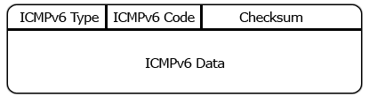
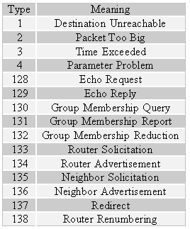
ICMPV6

Slide 38
ICMPv6
III. Fields
A. Type (8 bits)
1. Error message if high order bit is zero
2. Information message if high order bit is one
B. Code (8 bits)
Depends on message type
C. Checksum
To detect errors in message
D. Message Type
In an error it will have as much as possible of the packet that caused it.

Slide 39
Neighbor Discovery(RFC 2461)
I. Basics
Combines ARP and ICMP Router Discovery and Redirect
II. Nodes use ND for
A. Auto-configuration
B. Network prefixes, routes, and other config
C. Duplicate IP address detection
D. Layer 2 addresses of nodes on the same link
E. Neighboring routers to forward their packets
F. Keeping track of reachable and non neighbors
G. Noticing link-layer address changes

Slide 40
Neighbor Discovery(RFC 2461)
III. Improvement over the IPv4 protocols now used in ND
A. Router discovery
B. Router Advertisement has the link-layer address for the router
C. Router Advertisement has prefix for link (Subnet).
D. Easier process to renumber networks
E. Router Advertisements enable stateless address auto- configuration and inform hosts when to use stateful (DHCP).
F. Routers use it to notify of MTU for link
G. Multiple prefixes given either by the router or through redirect messages
H. Neighbor Unreachability Detection
I. Router Advertisements and redirects use link-local addresses to identify routers.
J. ND messages have a hop limit of 255 and aren’t answered if below.
K. IP Authentication and other security functions can be used.

Slide 41
Neighbor Discovery(RFC 2461)
IV. Five ICMP messages for ND
A. Router Solicitation and Router Advertisement
1. Hosts send a Router Solicitation message and the router responds with a Router Advertisement
2. Optional Extension to Router Advertisement
a. Used by routers to indicate preferences and more specific routes.
b. Allows host to pick a better route
3. Options field in Router Advertisement
a. Source link-layer address
b. MTU size
c. Prefix information for Stateless auto-configuration.

Slide 42
Neighbor Discovery(RFC 2461)
B. Neighbor Solicitation and Neighbor Advertisement
Two functions for this pair
1. Link-layer address resolution
2. Neighbor Unreachability Detection
C. ICMP Redirect Message
1. Used by routers to tell the node of a better first-hop node on the way to the destination.
2. Can inform the node that destination is a neighbor on same link and note a remote subnet.

Slide 43
Neighbor Discovery(RFC 2461)
V. Inverse Neighbor Discovery
A. An extension to ND.
B. Originally designed for Frame Relay networks.
C. RFC 3122
D. Has two messages
1. IND Solicitation
2. IND Advertisement
E. Similar to Reverse ARP
F. Same format as ND messages, but additional options
G. The Process
1. Host wants the IPv6 address for an interface. It knows the link-layer address.
2. Sends IND Solicitation to all-nodes multicast address.
3. On link layer, message sent to the interface.
4. Destination replies with IND advertisement with Target Address list.
5. If list too big, it sends multiple IND advertisements.

Slide 44
Neighbor Discovery(RFC 2461)
VI. Secure Neighbor Discovery (SEND)
A. Scenario: Node on link can identify itself as a default router and send forged Router Advertisement messages.
B. RFC 3971
C. Components
1. Certification Path Solicitation and Advertisment messages
2. Cryptographically Generated Address
3. Additional options
a. RSA Signature
b. Timestamp
c. Nonce
D. Can’t be used for
1. Nodes with static addresses
2. Addresses configured with IPv6 Stateless Auto- configuration.

Slide 45
Neighbor Discovery(RFC 2461)
VII. Link-Layer Address Resolution
A. When a node has an IP address and wants to know the Link-layer address (ARP in IPv4).
B. For nodes on the same link.
C. Neighbor Solicitation message sent to solicited node multicast address of the neighbor .
D. If destination is reachable, the node sends it’s link-layer address.

Slide 46
Neighbor Discovery(RFC 2461)
VIII. Neighbor Cache and Destination Cache
A. On every node
B. Neighbor Cache
1. List of neighbors traffic recently sent to.
2. Listed by Unicast address
3. Entries contain
a. Neighbor’s link-layer address
b. Flag showing if router or host
c. Whether packets are queued for neighbor
d. Neighbor’s reachability
e. Time when next unreachability detection will occur
4. Possible states
a. Incomplete
b. Reachable
c. Stale
d. Delay
e. Probe
C. Destination Cache
1. Information on local and remote destinations traffic has recently been sent to.
2. Information from ICMP redirect messages.
3. Can contain MTU sizes and roundtrip timers.

Slide 47
Neighbor Discovery(RFC 2461)
IX. Autoconfiguration
Allows renumbering of sites by prefixes
X. MLD (Multicast Listener Discovery)
Protocol for Multicast Listeners to register for Multicast addresses they want to use for efficient routing.
XI. Multicast Router Discovery
For discovering Multicast routers.

Slide 48
Auto-Configuration
I. Stateless
A. Good for small businesses and individuals
B. Provides IP address
II. Stateful
DHCPv6
A. Provides IP address and other parameters
B. Provides auditing, tracking, and management of address allocation

Slide 49
DHCPv6 (RFC 3315)
I. Reasons for DHCPv6
A. You have a certain addressing scheme
B. Need dynamic assignment of DNS servers
C. Don’t want the MAC address as part of the IPv6 address
D. Want to implement dynamic updates to DNS
E. Combine it with Stateless Configuration so it can provide additional information (RFC 3736).
II. Note
Router Advertisement has options to tell the client whether or not to use DHCP.
III. DHCPv6 uses these multicast addresses
A. All_DHCP_Relay_Agents_and_Servers
1. FF02::1:2
2. All DHCP agents which are servers and relays are part of this group.
3. DHCP clients use it to reach the DHCP agents.
B. All_DHCP_Servers address
1. FF05::1:3
2. All DHCP servers in a site are in this group
3. Used by the relays to reach the servers in the site.

Slide 50
DHCPv6 (RFC 3315)
IV. UDP Ports
A. UDP port 546
1. For clients to listen for DHCP messages
2. For servers and relays to use as destination port for the clients.
B. UDP port 547
1. For servers and relays to listen on.
2. Clients use this for destination port for servers and relays.
3. Relays use it to reach servers

Slide 51
DHCPv6 (RFC 3315)
V. Message types
A. SOLICIT – 1
For clients to locate dhcp servers
B. ADVERTISE – 2
For servers to respond to Solicit
C. REQUEST - 3
For clients to get info from servers
D. CONFIRM - 4
For clients to verify that their address and config are valid for the link
E. RENEW – 5
For clients to extend their address and parameters
F. REBIND – 6
For clients to extend their address to other DHCP server because their RENEW was not acknowledged.
G. REPLY – 7
For DHCP servers to respond to Solicit, Request, Renew, and Rebind messages.

Slide 52
DHCPv6 (RFC 3315)
H. RELEASE – 8
For clients to release their IP addresses
I. DECLINE – 9
For clients to tell the server that one or more addresses are already being used.
J. RECONFIGURE – 10
For servers to tell clients that there is new or changed config info. Client in turn submits a Renew or Information Request for the information.
K. Information Request – 11
For clients to request new parameters
L. RELAY-FORW – 12
For relays to forward client messages to servers. May either be forwarded directly or to other relay agents being encapsulated each time.
M. RELAY-REPL – 13
For servers to send messages back to clients same path back - through one or more relays.

Slide 53
DHCPv6 (RFC 3315)
VI. DHCP Message format
A. DHCP Header
1. Message type – 1 byte
2. Transaction ID – 3 bytes
3. Options – variable
B. DHCP Option fields
1. Option Code – 2 bytes
2. Option Length – 2 bytes
3. Option Data – Variable

Slide 54
DHCPv6 (RFC 3315)
VII. DHCP Options
A. Client Identifier – 1
For the client DUID
B. Server Identifier – 2
For the server DUID
C. Identity Association for Nontemporary Addresses (A_NA) – 3
D. Identity Association for Temporary Addresses (IA__TA) – 4
E. IA Address - 5
Used to indicate the address associated with IA_NA or IA_TA.
F. Option Request – 6
a. Used in a message between client and server to identify a list of options.
b. Can be in a Request, Renew, Rebind, Confirm, or Information Request message.
c. Server can use this in a Reconfigure message for saying what is changed or added.

Slide 55
DHCPv6 (RFC 3315)
G. Preference – 7
Sent by a server to convince the client to use it as it’s DHCP server
H. Elapsed Time – 8
Time when the client started the DHCP transaction.
I. Relay Message – 9
Has the original message in a Relay forward or Relay reply.
J. Authentication – 11
Has the information to authenticate the identity and content of DHCP messages.
K. Server Unicast – 12
IP address of the server for the client to use to communicate.

Slide 56
DHCPv6 (RFC 3315)
VIII. Header fields in Relay Agent and server messages
A. Message type – 1 byte
B. Hop count – 1 byte
C. Link Address – 16 bytes
D. Peer Address – 16 bytes
E. Options – variable
IX. DHCP Unique Identifier
A. Each DHCP client and server has one.
B. Server uses it for sending the configuration needed for a specific client.
C. Should not be changed once assigned.
D. Types
1. Link-layer address plus time (DUID-LLT)
2. Vendor-specific unique ID based on enterprise number(DUID-EN)
3. Link-layer address (DUID-LL)

Slide 57
DHCPv6 (RFC 3315)
X. Identity Association
A. An object for the client and server to use for the identification and management of a group of addresses.
B. IAID is chosen by the client to identify a group of addresses for one of it’s interfaces. It is used to get the configuration for the interface from the server.
C. Configuration is chosen from the following criteria
1. The link that the client is connected to.
2. DUID of the client
3. Other information given through options from the client
4. Added options from Relay Agents
XI. Security
To exchange messages securely IPSec is used.

Slide 58
Auto-Configuration Process
I. When a IPv6 device is connected it sends a link-local multicast router solicitation request for parameters.
II. Router responds with router advertisement packet. Contains:
A. Managed Address Configuration Flag (M Flag)
When 1 is indicated, it means a configuration protocol like DHCPv6 should be used for a stateful address.
B. Other Stateful Configuration Flag (O Flag)
When set at 1, the host should use a configuration protocol for other TCP/IP parameters.
C. DHCPv6 servers and relay agents use UDP port 547.

Slide 59
Auto-Configuration process continued
III. M and O values combined
A. M and O at zero
1. No DHCPv6 server
2. Device uses router advertisement for non-link- local address.
3. Manual configuration for other parameters.
4. Good for small organizations and individuals.
B. M and O at one
1. IPv6 address and configuration obtained from
DHCPv6 server.
2. Called DHCPv6 stateful addressing.
C. M is zero and O is one
1. Use stateless auto-config address
2. Obtain configuration from DHCPv6 server.
3. Called DHCPv6 stateless addressing
D. M is 1 and O is zero
1. Obtain IPv6 address from DHCPv6 server.
2. Other parameters from other methods.
3. Rarely used.

Slide 60
IPsec
I. Basics
A. Mandatory for IPv6
B. Provides:
1. Confidentiality
2. Data Integrity
3. Anti-replay protection
4. Key Management (IKE and IKEv2)
C. Two modes
1. Transport Mode
a. End systems initiate and receive protected traffic
b. IP Payload is encapsulated.
2. Tunnel Mode
a. Gateways handle traffic between hosts to protect traffic.
b. Entire IP Packet is encapsulated.
II. Implemented with Authentication Header(AH) and Encapsulating Security Payload (ESP) Extension Header. Can be used alone or t ogether.

Slide 61
IPsec
A. Authentication Header (Authentication) –
1. Provides origin authenticity, connectionless integrity, and protection against replay attacks.
2. Protects the Authentication Header itself, Destination Options extension Header, and IP Payload.
3. Protects the fixed IP Header, extension headers before the AH except for mutable fields (DSCP, ECN, Flow Label, and Hop Limit).
4. Runs on top of IP with IP Protocol 51.
B. Encapsulating Security Payload (Authenticate and encrypt)
1. Provides origin authenticity, connectionless integrity, and confidentiality of packets. Also provides an anti-replay service.
2. Does not protect the IP Packet Header like AH.
3. Runs on top of IP with IP protocol 50.

Slide 62
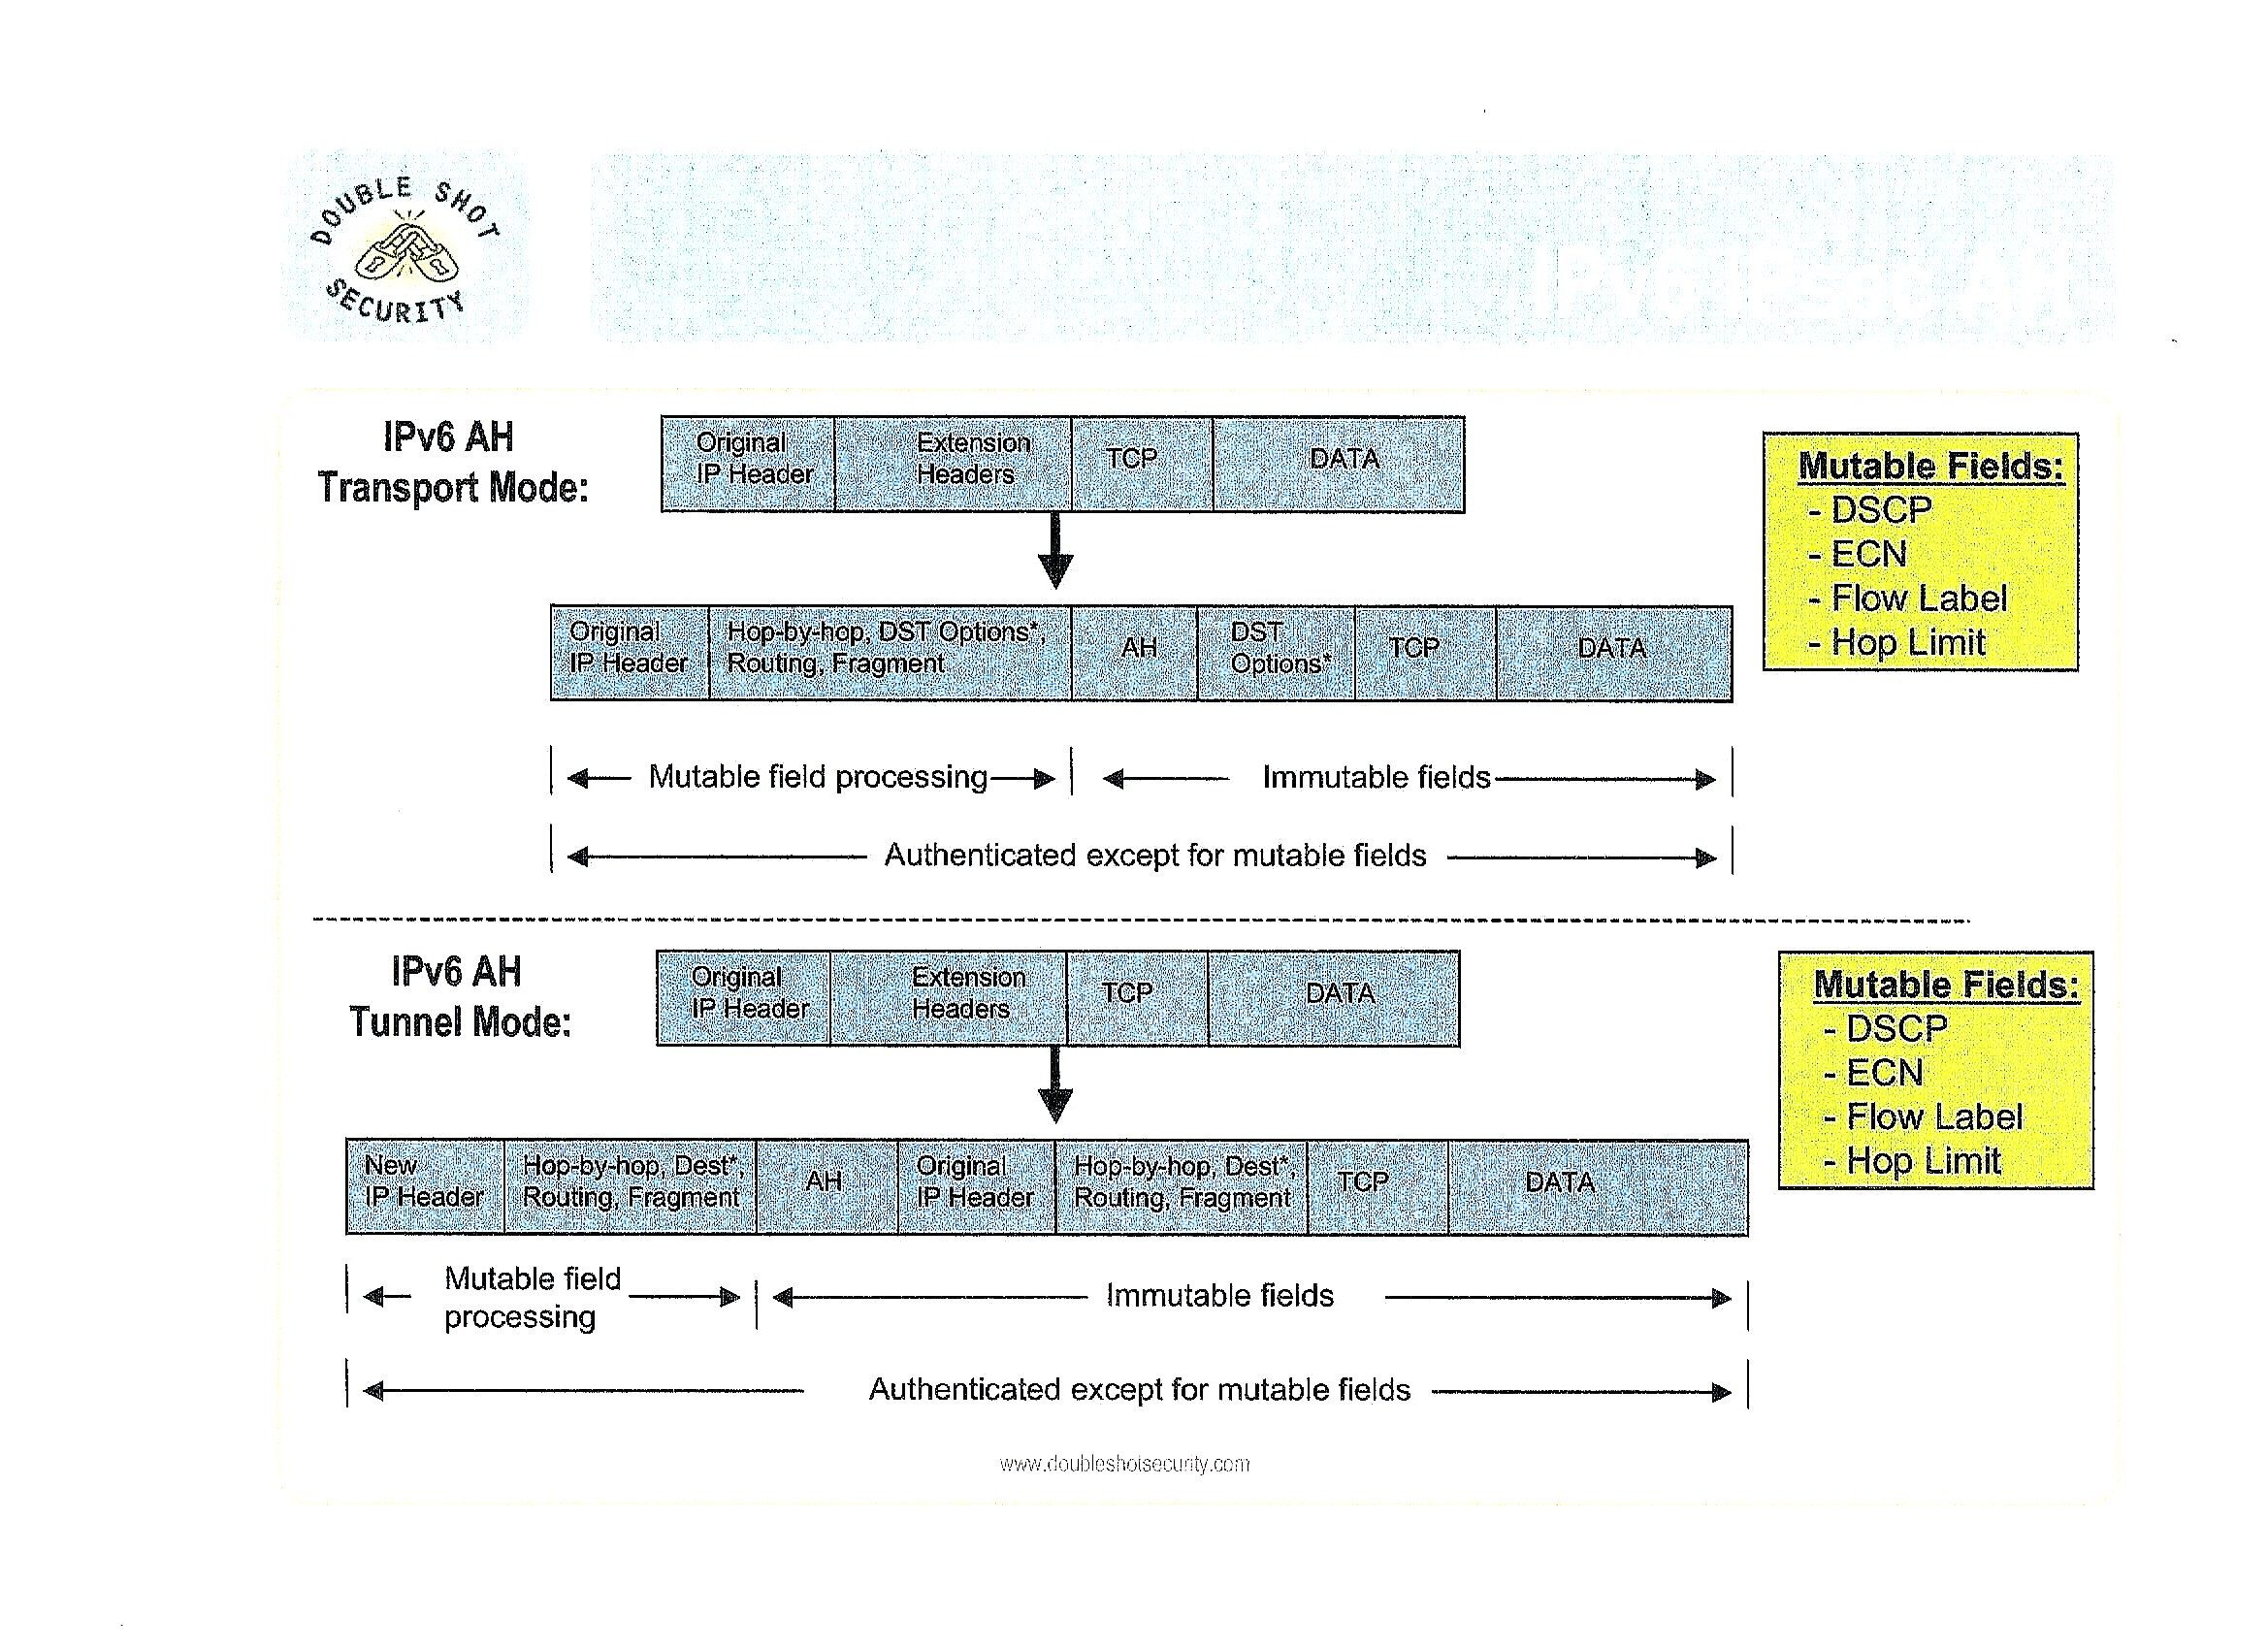

Slide 63
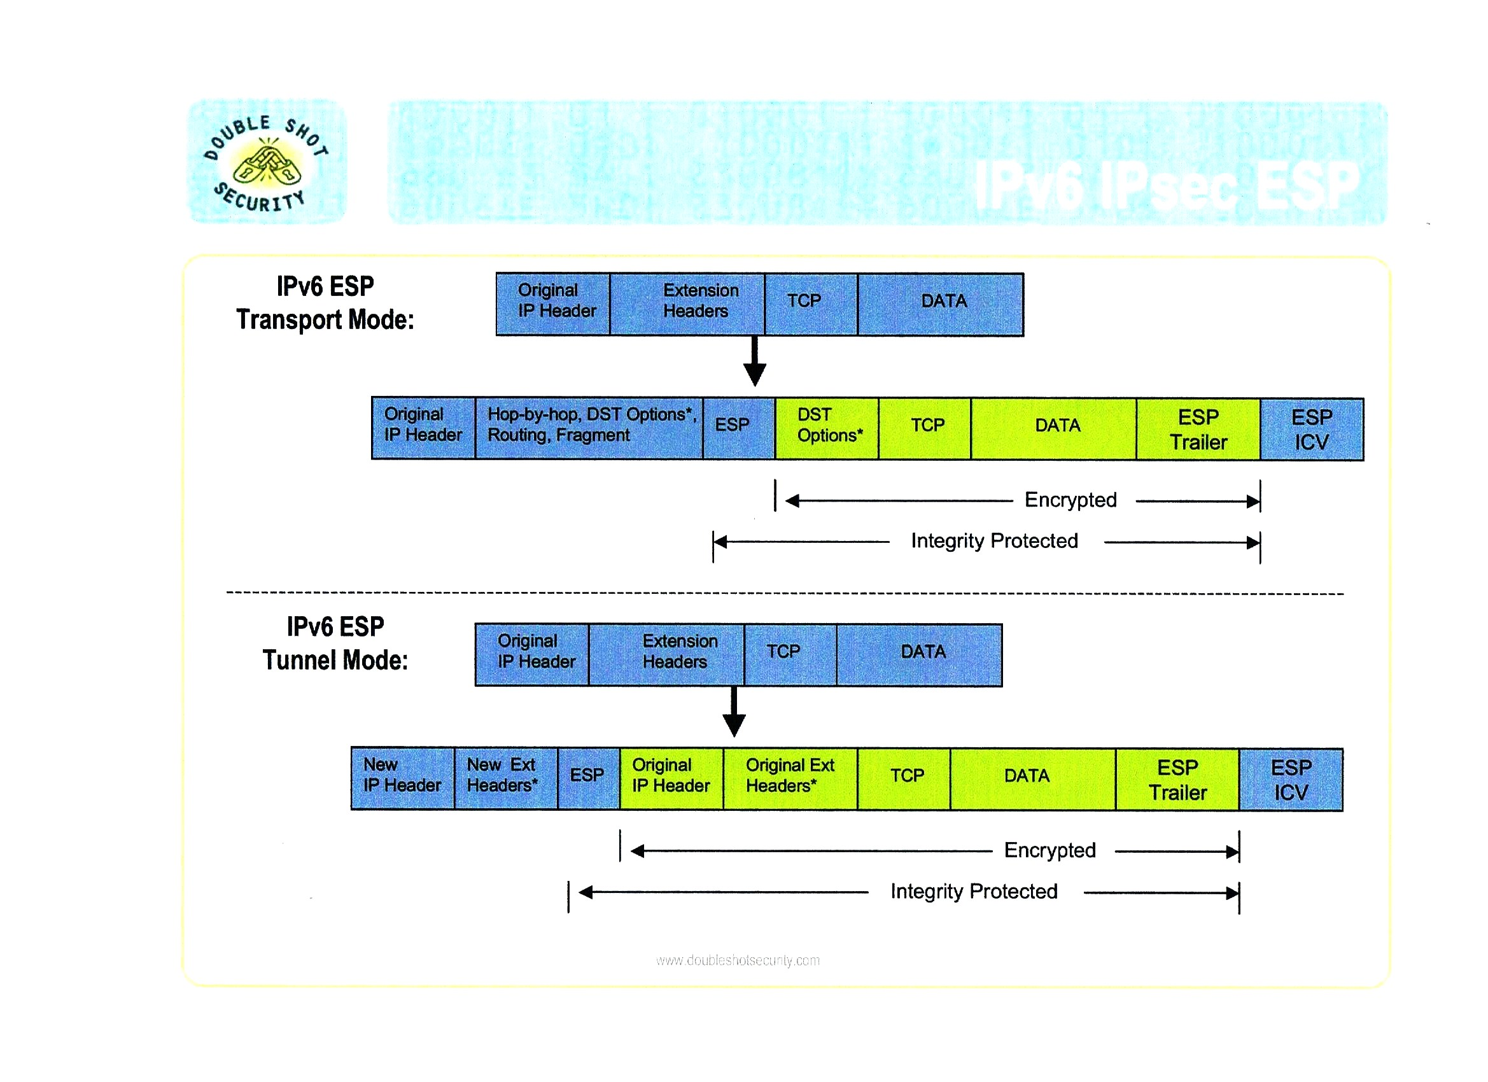

Slide 64
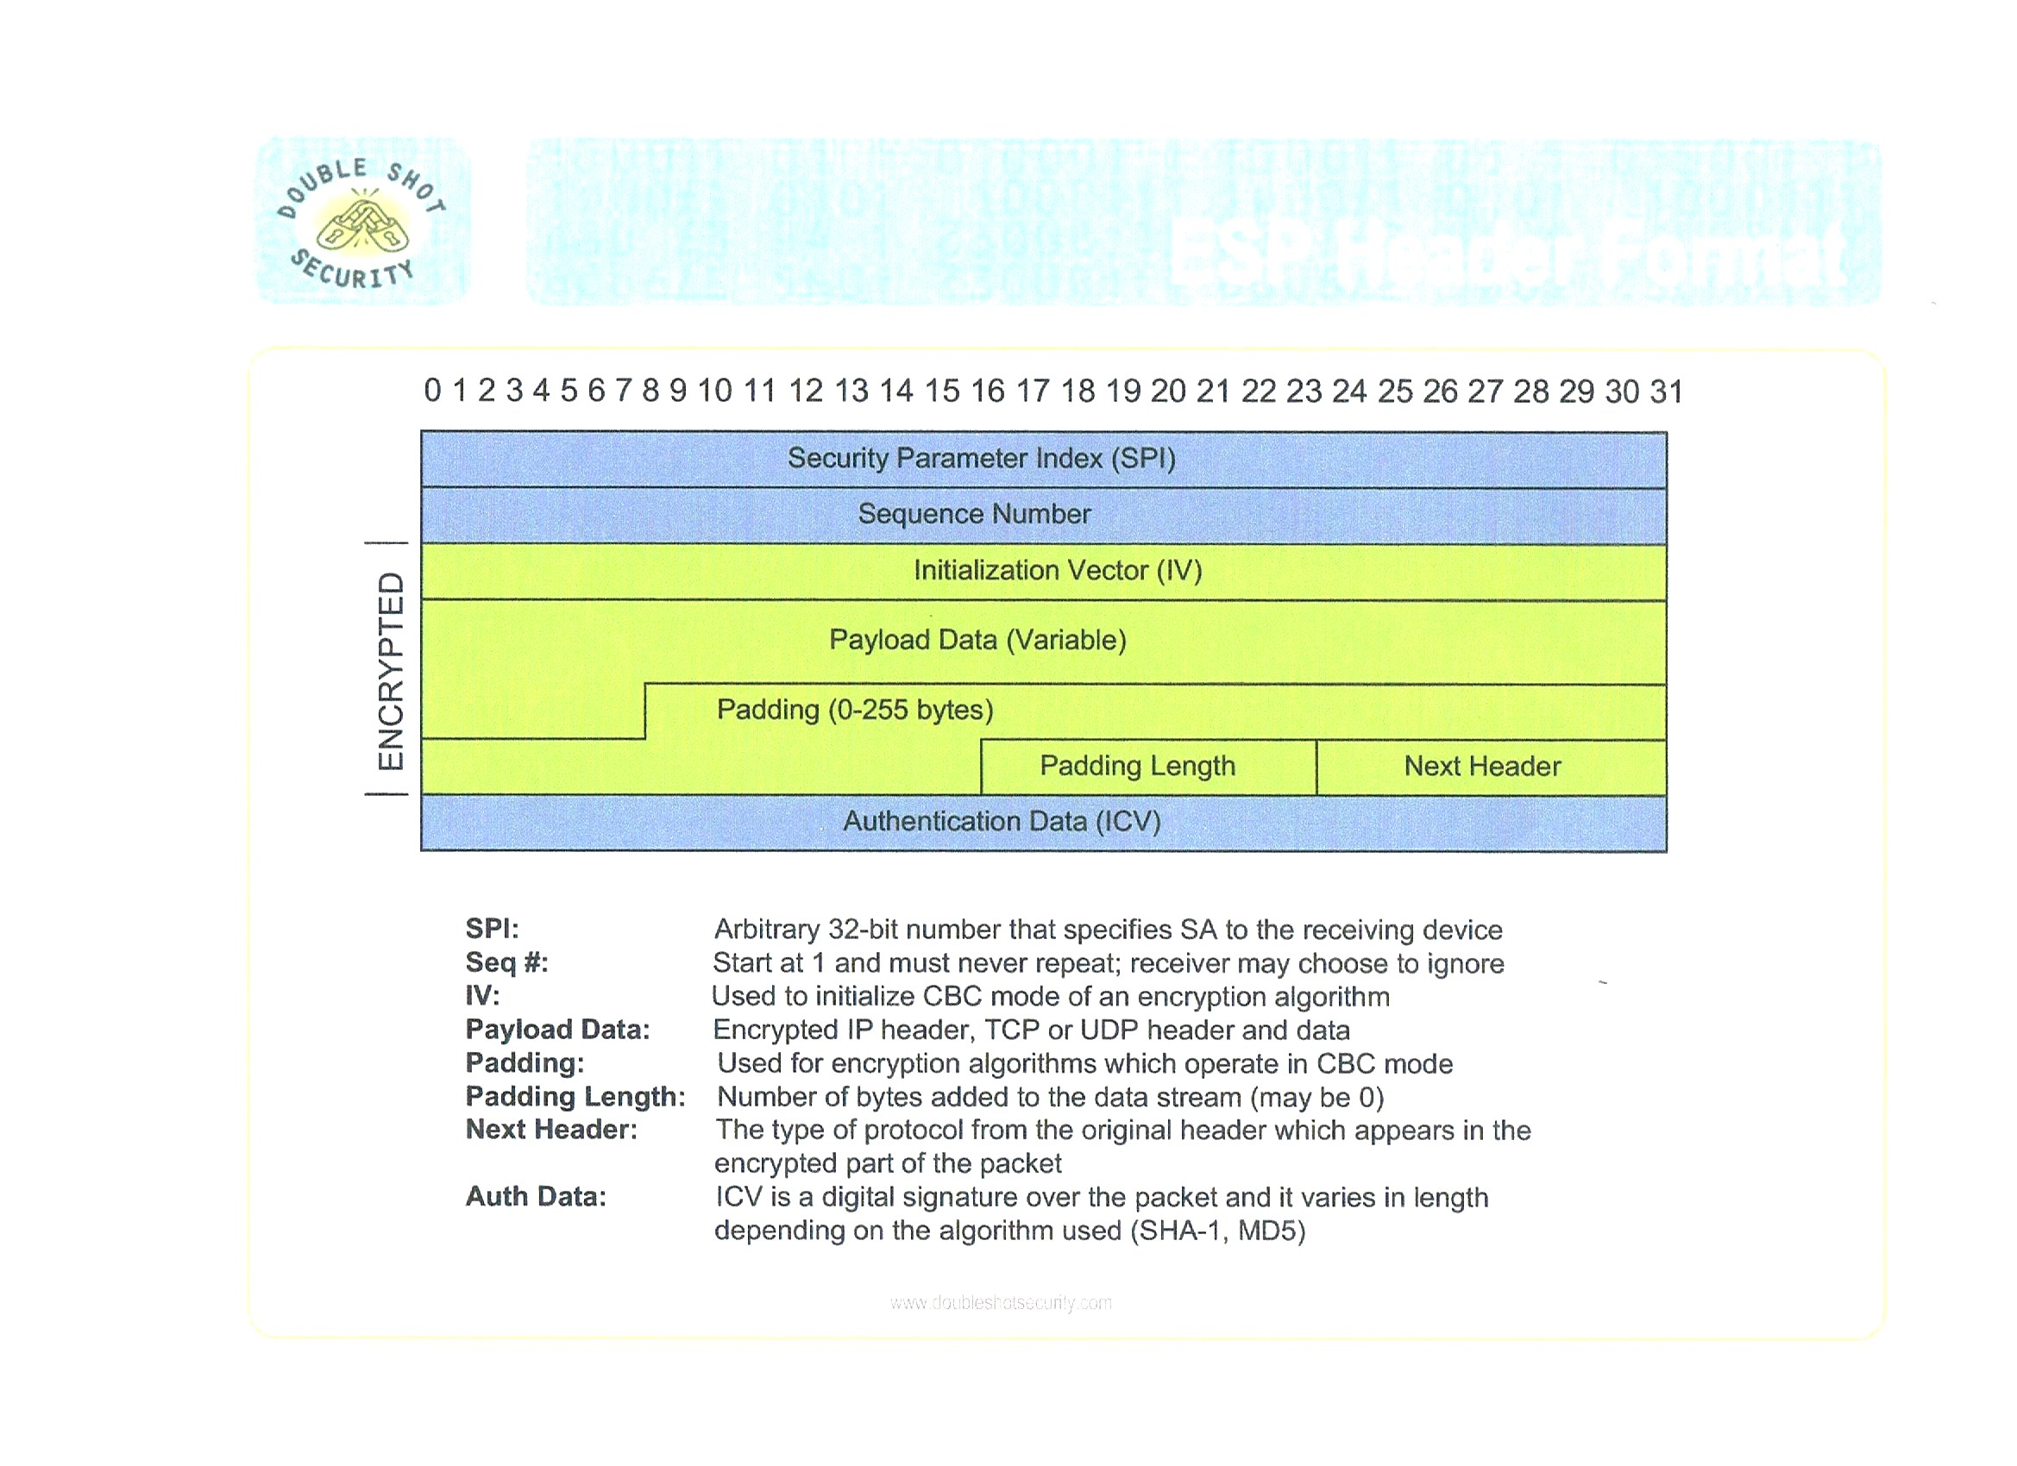

Slide 65
IPsec
III. Databases
A. Security Policy Database (SPD)
1. Security policy – Rule programmed into IPsec implementation that tells it how to process different datagrams.
2. Security policies for a device stored in the device’s SPD.
B. Security Association Database (SAD)
1. Security Association (SA) – A “contract” that specifies the security mechanisms used for the secure communication between devices.
2. Device’s security associations are in it’s SAD.
C. Peer Authorization Database (PAD)
1. To identify the peers or groups of peers authorized to communicate with the Ipsec entity.
2. The database provides a link between an SA management protocol (Like IKE) and the SPD.

Slide 66
IPSec
Authentication
Can use crytographic hashes such as MD5 or SH-1.
Keys
A. Manual set-up.
B. IKE (Internet Key Exchange)
Encryption
Can use DES, 3DES, Blowfish, AES

Slide 67
ROUTING
I. Routing table
A. Explanation
1. Each IPv6 route in the table is stored in an IPv6 address prefix and it’s length, plus additional information.
2. When each IPv6 packet comes in, the router looks at the destination address and looks in the routing table.
3. Prefix is compared to the ones in the routing table, and starts with the routes with the longest prefixes.
4. If match found, other entries are ignored.
B. Entry for each route
1. IPv6 prefix and prefix length
2. Next Hop Address
3. Next Hop Interface
4. Metric
5. Timer
6. Route Source (Protocol)

Slide 68
ROUTING
II. Routing methods
A. Static
1. Used and configured the same way as with IPv4.
2. Shouldn’t use a global unicast address as a next hop address with routing (RFC 2461)
B. RIPng
1. RIP made for IPv6.
2. Based on RIPv2 with following changes
a. Uses IPv6 for transport
b. IPv6 prefix, and next hop IPv6 address
c. Uses multicast group FF02::9 for updates
d. Updates sent on port 521
3. RFC 2080
C. IS-IS for IPv6
Most of the operational characteristics unchanged but IPv6 support is added.

Slide 69
ROUTING
D. OSPFv3 (OSPF for IPv6)
1. Enhanced OSPFv2.
2. Distributes IPv6 prefixes
3. Runs directly over IPv6
4. Added IPv6 attributes
a. 128 bit addresses
b. Link-local address
c. Multiple addresses and instances per interfaces
d. Authentication with IPSec
e. Runs over a link instead of subnet.
5. RFC 2740
E. MP-BGP
1. Makes BGP-4 available for IPv6.
2. RFC 2545/2858
F. EIGRP for IPv6
Same as for IPv4 but there is a module for IPv6

Slide 70
DNS (RFC 3596)
I. Since DNS is an upper layer protocol, somewhat removed from IP, the changes are not too extreme.
II. Three main modifications
A. New resource record
1. AAAA – mnemonic to represent that the address is 4 times the size of IPv4.
2. Structured same way as A record, but it is just larger.
3. Type value is 28.
B. New reverse Resolution Hierarchy
1. Whereas IN-ADDR.ARPA (Special domain) is appended to the reverse of a IPv4 address for reverse lookups, a new domain for IPv6 – IP6.ARPA is used.
2. Since IPv6 addresses are in hexadecimal, there are 16 subdomains 0 to F, with each of those having subdomains.
C. Change in Query types
Existing additional query types for A records must also do AAAA records.

Slide 71
DNS (RFC 3596)
III. Additional consideration
DNS servers can be queried and respond to queries over IPv4 as well for IPv6.
IV. Clients DNS servers as Resolvers
Must be able to handle all record types for IPv4 and IPv6.

Slide 72
QoS (For IP Telephony, Streaming audio, video)
I. Two main architectures
A. Integrated Services (IntServ)
1. Bandwidth and relevant resources per flow reserved end-to-end.
2. RSVP(Resource Reservation Protocol) is part of this.
a. Signaling protocol.
b. Reserves bandwidth and other QoS resources
3. Disadvantages
a. Implementation quite involved
b. Cannot scale well.

Slide 73
QoS
B. Differentiated Services (DiffServ)
1. DS field
a. Defines the ToS field of the IPv4 Header and the Traffic Class field in the IPv6 Header.
b. Specifies 64 codepoints.
c. DS routines of routers are determined from this field.
d. Known as DSCP – Differentiated Services Code Point - 6 bit field.
2. Communication between nodes is with Per-Hop Behavior (PHB).
a. Number of PHBs are unlimited.
b. Determines how packets are forwarded.
c. Selected by DSCP.
3. DS Domain – Contiguous group of DS routers.
4. DS region - Set of contiguous DS Domains.
5. Packet classifiers
a. Behavior Aggregate Classifier (BA) – Based on DS field
b. Multi Field Classifier (MF) – Based on single or multiple header fields.
6. Scalable and can be used in large networks and the Internet.

Slide 74
QoS
II. Two fields in IPv6 Header for QoS
A. Traffic Class
1. 1 Byte
2. Used by nodes and routers to identify class and priority of packets.
B. Flow Label
1. 20 bits
2. Assigned by source.
3. There can be a number of flows between source and destination.
4. Labels chosen randomly between 00001 to FFFFF.
5. Hosts or routers not using this label set the field to all 0s.
6. All packets in the flow have the same IP and port source and destination.
7. All packets must have the same Hop-By-Hop Options Header if used, and same Routing Extension Header if used.

Slide 75
QoS
III. Extension Headers
A. Routing Extension
Can be used to request a certain route through a sequence of nodes
B. Hop-By-Hop Options
Can be used to transport at most one router alert signaling message for each packet telling the router to process the packet.

Slide 76
IPv6 MOBILITY SUPPORT (RFC 3775)
I. Roaming of mobile Nodes – Point of attachment to Internet without IP address changing.
Can be used for wired networks
II. Connections to nodes made without user interaction with a specific assigned address.
III. Uses IPv6 features:
A. Address auto-configuration
1. Stateless (Network prefix + Interface ID)
2. Stateful (DHCPv6)
B. Neighbor Discovery
C. Extension Header
Uses route optimization

Slide 77
IPv6 MOBILITY SUPPORT (RFC 3775)
V. Main points
A. Home address
1. Global unicast address assigned to moble phone.
2. Used with home link.
B. Care-of- address
1. Global unicast address for the mobile phone to use while away from home and in a foreign link.
2. Mobile phone may have multiple care-of- addresses.
3. Primary care-of-address is the one registered with the home agent.

Slide 78
TRANSITION METHODS
I. Dual Stack
A. Nodes that have both protocols are called IPv6/IPv4 nodes.
B. Can send and receive both.
C. Possible configurations
1. IPv6 enabled, IPv4 disabled
2. IPv4 enabled, IPv6 disabled
3. IPv6 and IPv4 enabled
D. Dual Stack Network
1. Both are forwarded on routers
2. Both are kept in routing tables.
3. Takes more memory and CPU power on routers

Slide 79
TRANSITION METHODS
II. Tunneling
A. Also called encapsulation
B. Can be used in a variety of ways
C. 3 components
1. Encapsulation at tunnel entrance
2. Decapsulation at tunnel exit point
3. Tunnel management
D. Scenarios
1. Allows you to have a IPv6 network and use a IPv4 provider to get to other IPv6 hosts or networks.
2. IPv6 islands in corporate network with IPv4 backbone.
E. Types
1. Manually configured tunneling
a. IPv6 packets encapsulated in IPv4 packets and sent through IPv4 routing.
b. Point to point tunnels that need to be configured manually.
2. Automatic Tunneling
a. IPv6 nodes using different kinds of addresses.
b. These IPv6 unicast addresses carry an IPv4 address in parts of IPv6 address fields.
F. Hop Limit
IPv6 –over-IPv4 tunnel is a single hop.

Slide 80
TRANSITION METHODS
G. Ways of Tunneling
1. Router-to-Router
2. Host-to-Router
3. Host-to-Host
4. Router-to-Host
III. Tunneling in IPv6
A. Packets are encapsulated in a IPv6 header
B. Packet can be
1. IPv4 Packet
2. IPv6 Packet
3. Any other protocol
C. One or set of Extension headers may also be prepended at tunnel entrance.

Slide 81
TRANSITION METHODS
  IV. Methods of transition
A. 6to4
1. RFC 3056
2. IPv6 sites communicate between each other over IPv4 network without a tunnel . 6to4 routers are used that are also configured for IPv6.
3. At least one global IPv4 unicast address required with the prefix 2002::/16. 80 bits leftover(16 for network, 64 bits for the node interface identifiers).
4. Not intended as a permanent solution.
B. ISATAP (Intra-Site Automatic Tunnel Addressing Protocol)
IPv6 connections for dual-stack nodes through tunnels over a IPv4 network.
C. Teredo
1. RFC 4380
2. IPv6 for hosts with one or more layers of NAT by tunneling packets through UDP.
3. Possible solution is to use 6to4 gateway on a NAT.
D. Tunnel Broker
1. RFC 3053
2. IPv6 providers for users that already connect to internet with IPv4.
3. Users register with the broker who manages the tunneled connections with Tunnel Servers (Dual Stack routers).
4. Good for small IPv6 installations.
E. IPv4/IPv6 coexistence using VLANs
F. Cisco 6PE
Based on hierarchical routing structure of MPLS(Multiprotocol Label Switching).
G. GRE (Generic Routing Encapsulation)
1. RFC 2784
2. To encapsulate any protocol in another protocol.
H. SSH
SSH tunnels can be used as simple transition mechanism.

Slide 82
TRANSITION METHODS
V. NAT-PT (Network Address Translation-Protocol Translation)
A. Uses SIIT (Stateless IP/ICMP Translation Algorithm)
B. RFC 2766
C. NAT Gateway sits between IPv6 and IPv4 networks and contains a pool of globally unique IPv4 addresses to assign to IPv6 nodes.
NAT64 and DNS64
Intended to replace NAT-PT

Slide 83
Windows
I. Fully Supported in
A. Windows 7
B. Windows Server 2008 R2
C. Windows Vista
D. Windows Server 2008
II. Considerations
A. Windows systems will default to tunneling over IPv4 unless the ISP specifies otherwise.
1. Need to have at least one public IPv4 address.
2. They will receive 6to4 prefix router advertisements from the directly connected systems.
B. Networks with NATs – Teredo
C. Enterprise networks - ISATAP

Slide 84
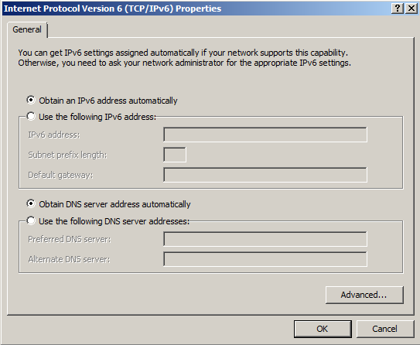
Windows

Slide 85
Apple
I. Version
Supported in MAC OS X v10.3 “Panther”
II. Config
A. Great support for 6to4
B. Tidbits
1. To start IPv6 on all interfaces
ip6 –a
2. To allow clients to accept Router Advertisements
sysctl –w net.inet6.ip6.accept_rtadv=1

Slide 86
LINUX
I. Versions and support
A. Red Hat
1. Red Hat Enterprise Linux Starting with 5.2
2. Enabling
You need to update and configure following files for IPv6 configuration:
/etc/sysconfig/network : Turn on networking in this file.
/etc/sysconfig/network-scripts/ifcfg-eth0 : Set default IPv6 router IP and server IP address in this file.
B. Suse Linux
1. Supported in Novell’s SUSE Linux Enterprise Server 10 SP2
2. Commands (Version 10)
# ip -6 address add {IPv6-Address}/{NetMask} dev {device-name}
# ip -6 address add 2607:f0d0:1002:0011:0000:0000:0000:0002/64 dev eth0
C. Ubuntu
1. Supported in version 8.10 and up
2. By default is turned on

Slide 87
UNIX
I. Sun
A. Version
First added with Solaris 8
B. Support
To assign a client an IPv6 IP address, just plumb it and it should pick up the network and the subnet parts (network prefix) from the nearest router. The assumption is that the network switch or router and the system have IPv6 support enabled.
For example:
ifconfig eri0 inet6 plumb up

Slide 88
UNIX
II. AIX
A. Version
Since version 4.3
B. To upgrade to IPv6 in version 5.2 and later.
1. Setup hosts for IPv6
2. Setup router for IPv6
3. Setup IPv6 to be configured on the hosts at boot time
4. Setup IPv6 to be configured on the router at boot time.
III. HP-UX
A. Version
Since version 11i v1
B. Configuring a Primary Interface
To configure a Primary Interface, edit an or edit an IPV6_INTERFACE[0] statement in the netconf-ipv6 file to specify the interface name, such as lan0. The interface name must be the name of the physical interface card, as reported by lanscan.
(This is from Installing and Administering HP-UX 11i IPv6 software)

Slide 89
z/OS (Mainframe)
I. Version
First supported in 1.4
II. Configuration

Slide 90
AS/400 (i5/OS)
I. Version
A. V5R4 more complete implementation than previous versions.
B. Added capabilities in V6R1
II. Configuration
A. By default it is started when you start TCP/IP.
B.
Configuring an IPv6 interface using the character-based interface
To create a normal IPv6 interface by using the character-based interface, follow these steps:
Note: To run the ADDTCPIFC command, you must have *IOSYSCFG special authority.
1. On the command line, type ADDTCPIFC (Add TCP/IP Interface command) and press F4 (Prompt) to access the Add TCP/IP Interface menu.
2. At the Internet address prompt, specify a valid IPv6 address.
3. At the Line description prompt, specify a line name (use any name) and press Enter to see a list of optional parameters.
4. Specify any of the other optional parameters that you want, and then press Enter.

Slide 91
CELL PHONES
I. iPhone
A. IPv6 always turned on. To work, it has to be connected to an IPv6 network.
B. Chooses address with the derived EUI-64.
C. Only uses Dual Stack
II. T-Moble
A. Has been aggressive with IPv6 implementation
B. Plans to use NAT64 for accessing IPv4 Internet until more IPv6 content is available.
C. Wants to have 50% traffic running over IPv6 by end of 2011.
III. AT&T
Slow to implement
Verizon
Has a dual-stack method over their LTE network.

Slide 92
CISCO
I. Version
A. First supported in 2001.
B. Information for this presentation is 12.4.
Switches
Packets are transparent. To switches because they are Layer 2 devices.
Routers
A. Setting up the Interface
1. ipv6 address <ipv6prefix>/<prefix-length> [eui-64]
2. You can specify the total 128 bit global address or use the eui-64 option (This option allows the device to use it’s MAC address with padding to make the interface ID)
3. Example
Corp(config-if)#ipv6 address 2001:db8:3c4d:1::/64 eui-64

Slide 93
JUNIPER
I. Version
Generally supported since 5.1.
Configuration
A. Enable IPv6 license to use IPv6 commands
Acquire the license from Juniper Networks Customer Services and Support or Juniper Networks sales representative.
Example
host1(config)#license ipv6 <license-value> Use the no version to disable the license
B. Configure interface
host1(config-if)#ipv6 address 1::1/64

Slide 94
Using IPv6 address in URL
RFC 2732
Use Brackets: []
Examples:
http://[FEDC:BA98:7654:3210:FEDC:BA98:7654:3210]:80/index.html http://[1080:0:0:0:8:800:200C:417A]/index.html http://[3ffe:2a00:100:7031::1] http://[1080::8:800:200C:417A]/foo http://[::192.9.5.5]/ipng http://[::FFFF:129.144.52.38]:80/index.html http://[2010:836B:4179::836B:4179]

Slide 95
INTERNET ORGANIZATIONS
I. IAB (Internet Architecture Board)
A. In charge of the technical and engineering development of the Internet by the ISOC(Internet Society).
B. Oversees IETF (Internet Engineering Task Force) and IRTF (Internet Research Task Force)
II. IANA (Internet Assigned Numbers Authority)
A. Oversees:
1. Global IP address allocation
2. Root zone management in DNS
3. Media Types
4. IP related symbols and numbers
B. Managed by ICANN
III. ICANN (Internet Corporation for Assigned Names and Numbers)

Slide 96
INTERNET ORGANIZATIONS
IV. IESG (Internet Engineering Steering Group)
A. Composed of members from IETF
B. Reviews Internet standards
V. IETF
A. Develops Internet standards: RFCs
B. Composed of volunteers

Slide 97
INTERNET ORGANIZATIONS
VI. IRTF (Internet Research Task Force)
Research for future Internet Technology
VII. ISOC (Internet Society)
International organization concerned with directing standards
VIII. W3C (World Wide Web Consortium)
Responsible for WWW standards
IX. RIR (Regional Internet Registry)
A. Oversees allocation and registration of Internet number resources
B. 5 RIRs throughout the world
1. ARIN(American Registry for Internet Numbers):US, Canada, and parts of the Caribbean
2. AfriNIC (African Network Information Centre): Africa
3. APNIC (Asia-Pacific Network Information Centre): Asia, Australia and neighboring countries
4. LACNIC (Latin America and Caribbean Network Information Centre) Latin America and other parts of the Caribbean
5. RIPE NCC (Reseau IP Europeens Network Coordination Centre) Europe, Middle East, Central Asia

Slide 98
DEPLOYMENT
I. IPv6 Forum
A. Founded by the IETF Deployment WG in Feb. 1999.
B. Resulted in the creation of regional and local IPv6 Task Forces
II. Aspects of deployment
A. In November 2008 the penetration was less than 1% in any country
1. Russia - .76%
2. France - .65%
3. Ukrane - .64%
4. Norway - .49%
5. US - .45%
B. Asia leads in absolute deployment and has huge demand for addresses.
C. Operating System Penetration
1. MAC OS – 2.44%
2. Linux - .93%
3. Windows Vista - .32%

Slide 99
COUNTRY BREAKDOWN
I. Australia
A. AARNet completed a new network – AARNet 3.
B. IPv6 Tunnel Broker called IPv6 Now Pty Ltd
C. Intermode – ISP
D. Victorian State Government granted funds for a IPv6 Testbed network
II. Canada
TekSavvy is deploying IPv6 network to customers as a Beta.
III. China
A. China Next Generation Internet
B. CERNET (China Education and Research NETwork) set-up CERNET2 for IPv6.
C. 2008 Olympic games used a IPv6 Infrastructure
Even taxis used it.
III. Germany
A. M-Net : Regional carrier and ISP established a IPv6 PoP.
B. 6WIN: Many scientific networks connected to this.
C. About 7 providers at the end of 2009 offer some kind of IPv6 implementation over their T-DSL network.

Slide 100
COUNTRY BREAKDOWN
IV. Finland
A. FICORA (Finnish Communications Regulatory Agency) Domain Name Registry added IPv6 capability to DNS servers so that IPv6 addresses can be entered when registering for domains.
B. In Feb 2008 one ISP had IPv6 capability.
V. France
A. AFNIC (NIC - Domain Name Registry) added IPv6 functionality.
B. Renater – French academic network has IPv6 connectivity.
C. Free – Major ISP has IPv6.
VI. India
Sify Technologies Limited, private ISP has dual-stack.
VII. Japan
NTT, Telecommunications company, touted as first public ISP to offer IPv6

Slide 101
COUNTRY BREAKDOWN
VIII. Luxembourg
A. RESTENA – Research and Education network had IPv6 for some years now.
B. P&T Luxembourg – Main telecom and Internet had IPv6 since Jan. 2009.
IX. Netherlands
A. SURFnet – Academic network had IPv6 since 1997.
B. XS4AII – Major ISP provides IPv6 DSL connectivity.
C. BIT BV – Business oriented provider has IPv6.
D. SixXS – Provides IPv6 tunnels worldwide
E. Signet – First ISP in this country to provide IPv6 over fiber.
X. Poland
A. Polish national research and education network – Native IPv6 connectivity available.
B. Polish Internet Exchange Facilitates IPv6 peering.

Slide 102
COUNTRY BREAKDOWN
XI. Sweden
Operators offering IPv6 access
A. Banhnhof
B. Tele2
XII. United Kingdom
A. JANET: UK’s education and research network uses IPv6.
B. Andrews and Arnold has non-tunneled IPv6 service.
C. Government is implemented a new PSN (Public Sector Network) using IPv6.
D. Entanet , communications provider, an early adopter of IPv6.

Slide 103
COUNTRY BREAKDOWN
XIII. United States
A. White House directive
1. Issued in September 2010 to implement IPv6 in public- facing web sites for all US Government agencies by Sept. 30, 2012.
2. Mandating use of native IPv6 and not transition methods.
3. Second deadline: Sept. 30, 2014 – Upgrade internal client applications that communicate with public Internet servers to use native IPv6.
a. Each agency has to have a transition manager.
b. Must purchase equipment and software that complies with federal government.
4. Memo released in a IPv6 workshop by the National Telecommunications and Information Administration.
B. Bush Administration mandated for a deadline of June 2008 for IPv6 backbone connectivity and was met.

Slide 104
COUNTRY BREAKDOWN
C. Cable
1. Meeting held by CableLabs – Cable Industry’s Research and Development Consortium, and National Cable & Telecommunications Association.
2. Comcast testing 3 transition methodologies and will have it’s network supporting IPv6 by 2012.
3. Other cable operators in other countries – Canada, Europe, and Japan will do public trials next year.
4. U.S. Cable industry prefers dual-stack.
D. Google
Held Conference in June 2010
E. AT&T
1. Some say it is lagging behind carriers such as:
a. Hurricane Electric
b. NTT America
c. Global Crossing
2. Have some IPv6 services available such as dual stack for Enterprise customers.
3. Absent at the Washington DC workshop and CableLabs meeting.
4. Was present at the Google conference.
5. Promising residential implementation by end of 2011 and MPLS-based hosting by end of 2010.

Slide 105
COUNTRY BREAKDOWN
F. Hurricane Electric
1. Has a IPv4/IPv6 backbone in Asia, North America, and Europe
2. Has a free IPv6 tunnel broker service
3. Has Facebook and Cisco as customers.
G. BlueCat
IPv6 Address Management
H. Verisign
1. Global registry operator for .com and .net.
2. Supported IPv6 since 2002.
I. Testing
1. University of New Hampshire InterOperability Laboratory
2. US Department of Defense
J. Verizon
First IPv6 devices available 4th qtr.
K. NTT America
1. Offered dual-stack and tunneling since 2004.
2. Customers
a. Web hosting companies
b. DNS Providers
c. Managed Security Services Providers
d. FAA.
L. Global Crossing
1. Tunnels IPv6 traffic over it’s MPLS core with 6PE
2. Devices at edge of it’s network support dual-stack

Slide 106
REFERENCES
Networking Applications
Bieringer, Peter, et al.. “Current Status of IPv6 Support for Networking Applications”. Deepspace6.net. Web.
<http://www.deepspace6.net/docs/ipv6_status_page_apps.html>
Other purposes for IPv6
Blankenhorn, Dana. “Open source vs. global warming”. ZDNet. Nov. 23, 2010. Web.
<http://www.zdnet.com/blog/open-source/open-source-vs-global-warming/7873>
Bluecat
Bluecat. “BlueCat Networks releases most complete IPv6 Address Management Platform”. BluecatNetworks.com. Oct 14, 2010. Web.
<http://www.bluecatnetworks.com/press-releases/2010/bluecat-networks-releases-most-complete-ipv6-address-management-platform>

Slide 107
REFERENCES
Moving to IPv6
Cacas, Max. “DoD research agency leads IPv6 transition”. Federalnewsradio. Nov. 11, 2010. Web.
<http://www.federalnewsradio.com/?nid=35&sid=2114320>
Application and patch database
Campus IPv6 Wiki. “IPv6 application and patch database”. Ipv6.niif.hu. Web.
<http://ipv6.niif.hu/m/ipv6_apps_db>
Porting applications
Castro, Eva M. “Porting applications to IPv6 HowTo”. Gsyc.escet. Web.
<http://gsyc.escet.urjc.es/~eva/IPv6-web/ipv6.html>

Slide 108
REFERENCES
Cisco config
Cisco. “Cisco IOS IPv6 Configuration Guide, Release 12.4”. Cisco. Web.
<http://www.cisco.com/en/US/docs/ios/ipv6/configuration/guide/12_4/ipv6_12_4_book.html>
IPsec
Cisco. “Implementing IPsec in IPv6 Security” . Cisco. Web.
<http://www.cisco.com/en/US/docs/ios/ipv6/configuration/guide/ip6-ipsec.html#wp1101822>
Routing
Cisco. “IPv6 Routing At-A-Glance”. Cisco. pdf file. Web.
<http://www.cisco.com/en/US/technologies/tk648/tk872/technologies_white_paper0900aecd80260051.pdf>
Ubuntu
Codingmyself. “How to set the static ipv4 and ipv6 address in ubuntu. Wordpress. Web.
<http://codingmyself.wordpress.com/2010/03/26/how-to-set-the-static-ipv4-and-ipv6-address-in-ubuntu/>

Slide 109
REFERENCES
Apple Mac OS
Evanjones.ca. “Collected Mac OS X IPv6 Wisdom”. Evanjones.ca. Web.
<http://evanjones.ca/macosx-ipv6.html>
IPsec
Friedl, Steve. “Steve Fiedl’s Unixwiz.net Tech Tips: An Illustrated Guide to IPsec”. Unixwiz.net. Web.
<http://unixwiz.net/techtips/iguide-ipsec.html>

Slide 110
REFERENCES
Red Hat Linux
Gite, Vivek. “Red Hat/CentOS IPv6 Network Configuration”. NixCraft. Jan. 23, 2009. Web.
<http://www.cyberciti.biz/faq/rhel-redhat-fedora-centos-ipv6-network-configuration/>
Suse Linux Config
Gite, Vivek. “Suse Linux (SLES10) IPv6 Configuration”. nixCraft. March 18, 2009. Web.
<http://www.cyberciti.biz/faq/configuring-ipv6-in-sles10-opensuse-linux/#comments>
Forum
Gogonet. IPv6 products, community and services. Gogonet.gogo6.com. Web.
<http://gogonet.gogo6.com/>
Google Conference
Google. Google IPv6 Implementors Conference. Google. June 10, 2010. Web.
<https://sites.google.com/site/ipv6implementors/2010/agenda>

Slide 111
REFERENCES
Moving to IPv6
Hachman, Mark. “IPv4 to IPv6 IP Address Transition Becoming Critical”. PCMAG.com. Oct. 18, 2010. Web.
<http://www.pcmag.com/article2/0,2817,2371036,00.asp>
Hagen, Silvia. IPv6 Essentials. Sebastopol, CA. O’Reilly Media, Inc. 2006.
Moving to IPv6
Halliday, Josh. “Google vicd-president issues stark internet warning”. Guardian.co.uk. Nov. 11, 2010. Web.
<http://www.guardian.co.uk/technology/2010/nov/11/google-vint-cerf-internet>
Moving to IPv6
Halsey, Mike. “Could the change to IPv6 Break the Internet?”. Ghacks.net. Nov. 11, 2010. Web.
<http://www.ghacks.net/2010/11/11/could-the-change-to-ipv6-break-the-internet/>
IP4 Status
Hurricane Electric. Hurricane Electric IPv4 Exhaustion Counters. Ipv6.he.net. Web.
<http://ipv6.he.net/statistics/>

Slide 112
REFERENCES
HP-UX
Hewlett Packard. “Installing and Administering HP-UX 11i”. docs.hp.com. pdf file. Web.
<http://docs.hp.com/en/T1306-90001/T1306-90001.pdf>
HP-UX
HP.com. “IPv6”. Hp.com. Web.
<http://h10026.www1.hp.com/netipv6/Ipv6.htm>
Subnet calculators
Hogg, Scott. “IPv6 Subnet Calculators”. NetworkWorld. Nov. 11, 2010. Web.
<http://www.networkworld.com/community/node/68781>
Deployment
Hurricane Electric. Global IPv6 Deployment Progress Report. Updated every day. Web.
<http://bgp.he.net/ipv6-progress-report.cgi>
Hurricane Electric
Hurricane Electric. Hurricane Electric IPv6. Web.
<http://ipv6.he.net/>

Slide 113
REFERENCES
AS/400
Ibm. IBM i6.1 Information Center. Ibm. Web.
<http://publib.boulder.ibm.com/infocenter/iseries/v6r1m0/index.jsp?topic=/clfinder/finder30.htm>
Hardware
Impress Media. “Billion gives IPv6 to X-Series customers in New Year”. Nov. 26, 2010. Web.
<http://www.impress.com.au/press-releases-mainmenu-1/billion-mainmenu-67/1094-billion-gives-ipv6-to-x-series-customers-in-new-year.html>
IPv6 – General
IPv6.com. Web.
<http://ipv6.com/>

Slide 114
REFERENCES
Apple MAC OS
Ipv6int.net. “Apple Mac OS X IPv6”. Ipv6int.net. Web.
<http://ipv6int.net/systems/mac_os_x-ipv6.html>
Sun Solaris
Ipv6int.net. “Solaris IPv6”. Ipv6int.net. Web.
<http://ipv6int.net/systems/solaris-ipv6.html>
Vendor Application Database
Ipv6-to-standard.org. “IPv6 to standard”. Ipv6-to-standard.org. Web.
<http://www.ipv6-to-standard.org/>

Slide 115
REFERENCES
IPSec
Kaeo, Merike. “IPv6 IPsec Availability” ARIN. Pdf file. Web.
<https://www.arin.net/participate/meetings/reports/ARIN_XXI/PDF/tuesday/ARIN-IPsecv6.pdf>
Canada
Keller, James. “What happens when the Internet runs out of IPs? We’re about to find out. The Canadian Press. Nov. 24, 2010. Web.
<http://www.winnipegfreepress.com/breakingnews/what-happens-when-the-internet-runs-out-of-ips-were-about-to-find-out-110419004.html>
UK
Kennedy, Steve. “The mind-boggling world of IPv6, and why it matters to the future of the Internet”. The Next Web. Nov. 20, 2010. Web.
<http://thenextweb.com/uk/2010/11/20/the-mind-boggling-world-of-ipv6-and-why-it-matters-to-the-future-of-the-internet/>
Lammle, Todd. CCNA Study Guide. Sixth Edition. Indianapolis, IN. Wiley Publishing, Inc. 2007.
LaPage, Andy. CompTIA A+ Certification Essentials. Axco Press. 2009.
Suse Linux
Levy, Roger. Letter to Richard J. Duncan. Novell. Pdf file. Web.
<http://jitc.fhu.disa.mil/adv_ip/register/certs/novell_suse_10_sp2_loc.pdf>

Slide 116
REFERENCES
Ireland
McCarra, Darren. “IPv6, Ireland, and the future of the internet. The Sociable. Nov. 27, 2010. Web.
<http://sociable.co/2010/11/26/ipv6-ireland-and-the-future-of-the-internet/>
UK
MarkJ. “Entanet UK Warns of Turbulent Times for ISPs that fail to Adopt IPv6”. ISPreview. Nov. 26, 2010. Web.
<http://www.ispreview.co.uk/story/2010/11/26/entanet-uk-warns-of-turbulent-times-for-isps-that-fail-to-adopt-ipv6.html>

Slide 117
REFERENCES
AT&T
Marsan, Carolyn Duffy. “AT&T Lagging While Others Lead on IPv6”. PCWorld. Oct. 27, 2010. Web.
<http://www.pcworld.com/businesscenter/article/208948/atandt_lagging_while_others_lead_on_ipv6.html>
Cable
Marsan, Carolyn Duffy. “U.S. cable companies embrace IPv6”. Computerworld. Oct. 28, 2010. Web.
<http://www.computerworld.com/s/article/9193939/U.S._cable_companies_embrace_IPv6?taxonomyId=16>
US
Marsan, Carolyn Duffy. “White House issues IPv6 directive”. Networkworld. Sept. 28, 2010. Web.
<http://www.networkworld.com/news/2010/092810-white-house-ipv6-directive.html>
Ubuntu
META/LPAR. “IPv6 with Bonjour/Zeroconf in Ubuntu”. Lpar.auth.com. Jan. 6, 2009. Web.
<http://lpar.ath0.com/2009/01/06/ipv6-with-bonjourzeroconf-in-ubuntu/>
Windows
Microsoft. “IPv6”. Microsoft. Technet. Web.
<http://technet.microsoft.com/en-us/network/bb530961.aspx>
Interface ID
Microsoft. “IPv6 interface identifiers.” Microsoft. Technet. Jan. 21, 2005. Web.
<http://technet.microsoft.com/en-us/library/cc736439(WS.10).aspx>

Slide 118
REFERENCES
Various OS
Mohacsi, Janos. “IPv6 host configuration”. 6diss.org. 2005. Pdf file. Web.
<http://www.6diss.org/workshops/saf/host-configuration.pdf>
iPhone
Morr, Derek. “IPv6 on iPhone”. Personal.psu.edu. Jone 21, 2010. Web.
<http://www.personal.psu.edu/dvm105/blogs/ipv6/2010/06/ipv6-on-iphone.html>
T-Mobile
Morr, Derek. “T-Mobile is pushing IPv6. Hard.” Personal.psu.edu. June 29, 2010. Web.
<http://www.personal.psu.edu/dvm105/blogs/ipv6/2010/06/t-mobile-is-pushing-ipv6-hard.html>

Slide 119
REFERENCES
Sun Solaris
Nagarajayya, Nagendra. “Migrating to IPv6 on the Solaris OS”. Oracle. March 2008. Web.
<http://developers.sun.com/solaris/articles/migratetoipv6/>
Transition
Network Working Group. “Basic Transition Mechanisms for IPv6 Hosts and Routers”. IETF. RFC 4213. Oct. 2005. Web.
<http://tools.ietf.org/html/rfc4213>
URL
Network Working Group. “Format for Literal IPv6 Addresses in URL’s”. IETF. RFC 2732. Dec. 1999. Web.
<http://www.ietf.org/rfc/rfc2732.txt>
IPv6
Network Working Group. “Internet Protocol, Version 6 (IPv6) Specification”. IETF. RFC 2460. Dec. 1998. Web.
<http://tools.ietf.org/html/rfc2460>
Mobile IPv6
Network Working Group. “Mobility Support in IPv6”. IETF. RFC 3775. June, 2004. Web.
<http://www.ietf.org/rfc/rfc3775.txt>

Slide 120
REFERENCES
Neighbor Discovery
Network Working Group. “Neighbor Discovery for IP Version 6 (IPv6)”. IETF. RFC 2461. Web.
<http://www.ietf.org/rfc/rfc2461.txt>
NAT-PT
Network Working Group. “Network Address Translation – Protocol Translation”. IETF. RFC 2766. Feb. 2000. Web.
<http://www.faqs.org/rfcs/rfc2766.html>
IPv6 in Ethernet
Network Working Group. “Transmission of IPv6 Packets over Ethernet Networks”. IETF. RFC 2464. Dec. 1998. Web.
<http://www.ietf.org/rfc/rfc2464.txt>
Oracle config
Oracle. IPv6 Administration Guide. Oracle. Web.
<http://docs.sun.com/app/docs/doc/817-0573?l=en>

Slide 121
REFERENCES
Ubuntu
Paulos. Ubuntu Documentation. Help.ubuntu.com. July 15, 2010. Web.
<https://help.ubuntu.com/community/WebBrowsingSlowIPv6IPv4?action=show&redirect=DisableIPv6>
IPv4 address exhaustion
Potaroo.net. IP Address Report. Web.
<http://www.potaroo.net/tools/ipv4/index.html>
India
Ramachandran, T. “IPv6 task force units will be in place soon. The Hindu. Web.
<http://www.hindu.com/2010/11/14/stories/2010111451570600.htm>
Red Hat Linux
RHEL5 Team. “Red Hat Enterprise Linux 5.2”. redhat. May 21, 2008. Web.
<http://press.redhat.com/2008/05/21/red-hat-enterprise-linux-52/>
IPsec
Rivkin, Ahmad. “IPsec basics”. E-articles.info. Web.
<http://e-articles.info/e/a/title/IPsec-Basics/>

Slide 122
REFERENCES
Company to help transition
San Francisco Chronicle. “Colocation America Announces their IPv6 Initiative”. San Francisco Chronicle. Oct. 26, 2010
<http://www.sfgate.com/cgi-bin/article.cgi?f=/g/a/2010/10/26/prwebprweb4700654.DTL#loopbegin>
Moving to IPv6
Smith, Chris. “While U.S. Adoption of IPv6 Increased in 2009, will 2010 See a Sharp Upswing?”. MC Press online. Jan. 4, 2010. Web.
<http://www.mcpressonline.com/internet/protocols/while-us-adoption-of-ipv6-increased-in-2009-will-2010-see-a-sharp-upswing.html>
IPsec Cheatsheet
Stretch, Jeremy. “IPsec”. Packetlife.net. Web.
<http://packetlife.net/media/library/6/IPsec.pdf>
IPv6 Cheatsheet
Stretch, Jeremy. “IPv6”. Packetlife.net. Pdf file. Web.
<http://packetlife.net/media/library/8/IPv6.pdf>

Slide 123
REFERENCES
DNS
Tcp/ip Guide. DNS Changes To Support IP Version 6. Tcpipguide.com. Web.
<http://www.tcpipguide.com/free/t_DNSChangesToSupportIPVersion6.htm>
IPv6-enabled daemons
Tldp.org. “Chapter 22. Hints for IPv6-enabled daemons”. Tldp.org. Linux IPv6 HOWTO. Web.
<http://tldp.org/HOWTO/Linux+IPv6-HOWTO/chapter-hints-daemons.html>
UK
TMCnews. “ENTANET: Entanet encourages IPv6 adoption and feedback”. TMCnet.com. Nov. 26, 2010. Web.
<http://www.tmcnet.com/usubmit/2010/11/26/5159594.htm>

Slide 124
REFERENCES
iPhone4
Ullrich, Johannes B. “IPv6 Support in iOS 4”. Computer Security. June 23, 2009. Web.
<http://www.computersecurityarticles.info/security/ipv6-support-in-ios-4-wed-jun-23rd/>
Hardware
Vahalia, Kunal. “Cisco Explains What Organizations Need to Consider When Migrating to IPv6”. TMC.net.com. Nov. 22, 2010. Web.
<http://dns.tmcnet.com/topics/dns/articles/119757-cisco-explains-what-organizations-need-consider-when-migrating.htm>
Transition
Vaughan-Nichols, Steven. “Five ways for IPv6 and IPv4 to peacefully co-exist”. ZDNet. Oct. 14, 2010. Web.
<http://www.zdnet.com/blog/networking/five-ways-for-ipv6-and-ipv4-to-peacefully-co-exist/244>
Windows
Vaughan-Nichols, Steven. “Fixing Windows 7 IPv6 Headaches”. ZDNet. Oct. 19, 2010. Web.
<http://www.zdnet.com/blog/networking/fixing-windows-7-ipv6-headaches/257>
Windows
Vaughan-Nichols, Steven J. “Use IPv6 in Windows 7 Today”. ZDNet. Nov. 19, 2010. Web.
<http://www.zdnet.com/blog/networking/use-ipv6-in-windows-7-today/352>

Slide 125
REFERENCES
Apple Mac OS
Whatismyipv6.com. MacOSX IPv6 Networking Knowhow. Whatismyipv6.com. Web.
<http://www.whatismyipv6.com/blogs/macipv6/wordpress/>
Application support
Wikipedia. “Comparison of IPv6 application support”. Wikipedia. Web.
<http://en.wikipedia.org/wiki/Comparison_of_IPv6_application_support>
Router support
Wikipedia. “Comparison of IPv6 support in routers”. Wikipedia. Web.
<http://en.wikipedia.org/wiki/Comparison_of_IPv6_support_in_routers>

Slide 126
REFERENCES
6to4
Wikipedia. “6to4”. Wikipedia. Web.
<http://en.wikipedia.org/wiki/6to4>
Tunnel Brokers
Wikipedia. “List of IPv6 tunnel brokers”. Wikipedia. Web.
<http://en.wikipedia.org/wiki/List_of_IPv6_tunnel_brokers>
IPsec
Wikipedia. IPsec. Wikipedia. Web.
<http://en.wikipedia.org/wiki/Ipsec>
IPv6
Wikipedia. “IPv6”. Wikipedia. Web.
<http://en.wikipedia.org/wiki/IPv6>

Slide 127
REFERENCES
Deployment
Wikipedia. “IPv6 deployment”. Wikipedia. Web.
<http://en.wikipedia.org/wiki/IPv6_deployment>
Teredo
Wikipedia. “Teredo Tunneling”. Wikipedia. Web.
<http://en.wikipedia.org/wiki/Teredo_tunneling>
Moving to IPv6
Williams, Owen. “ The IPcalypse is only 100 days away”. Neowin. Nov. 22, 2010. Web.
<http://www.neowin.net/news/the-ipcalypse-is-only-100-days-away>

